Slide 2
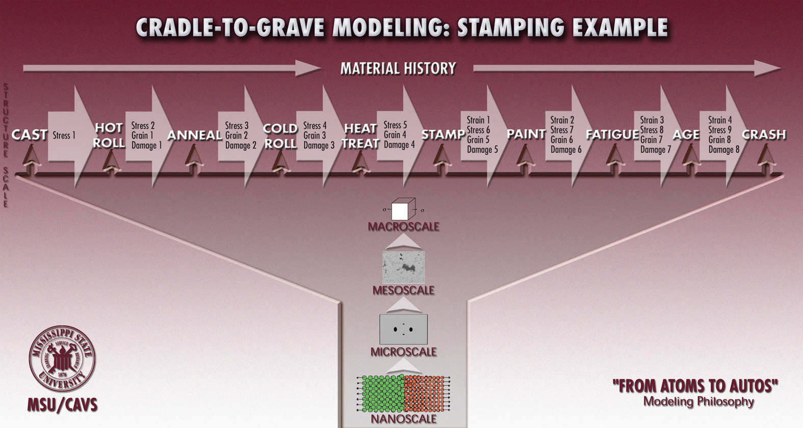
Process-Structure-Property Modeling and the Associated History
Requires: 1. theory, 2. computations, and 3. experiments

Slide 3
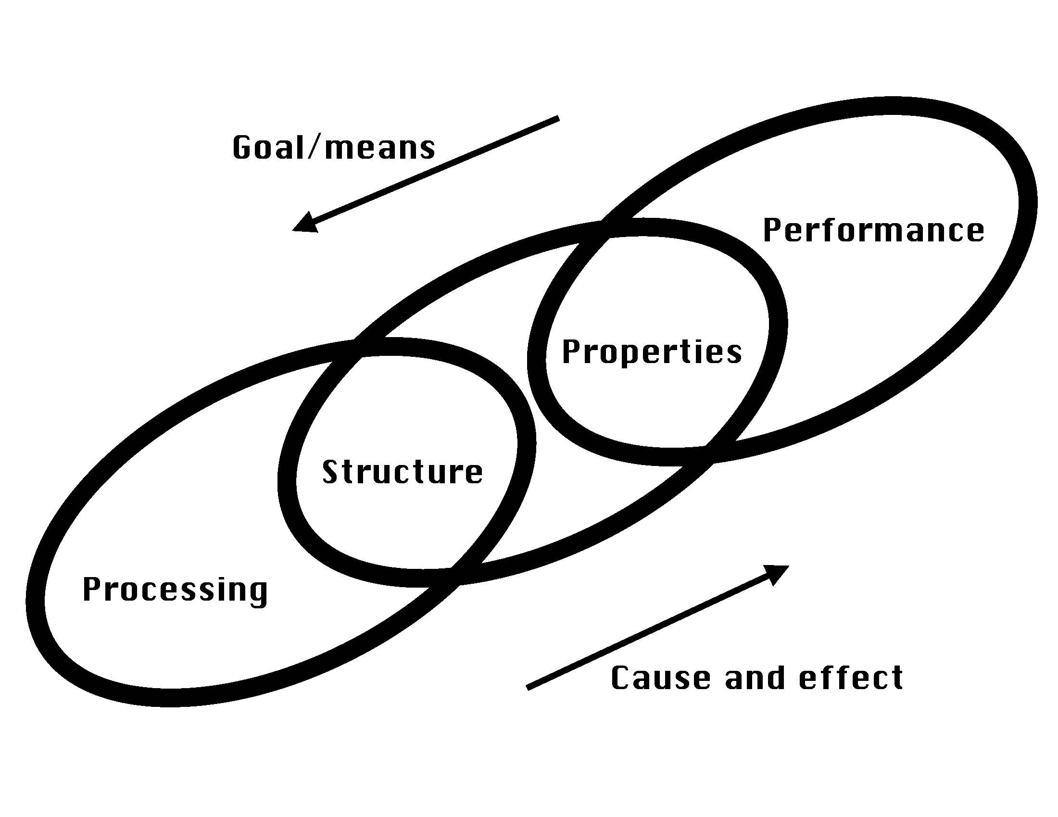

Slide 4
History is important to predict the future!!
25% wrong answer
if history is not
considered!!
304L SS

Slide 5
Solving Complex Engineering Problems
Metals
Polymers
Ceramics
Composites
Biological materials
Macroscale Internal
State Variable Theory
BVP
Multiscale
Modeling
Material
Heterogeneities

Slide 6
Macroscale MSU ISV/MSF
Models Implementation/Use
ISV=Internal State Variable
MSF=MultiStage Fatigue
mesh
initial microstructure-
inclusion content
Finite
Element
Code
(ABAQUS)
MSU
MSF
Model
σ, ε, φ
Life
MSU
DMG
model
failure
Design
Multiscale
Materials
Modeling
Note: model can
be implemented
in other FE codes
boundary conditions
loads
temperature
strain rate
history
Note: the ISV and MSF
models give a 95% correct
answer where current models
in codes give a 50% answer
Physics Validation
And
Numerical Verification

