Slide 1



Integrated Computational Materials Engineering (ICME) for Metals
Reinvigorating Design with Science and Engineering
MIT Presentation (4.25.12)
Dr. Mark F. Horstemeyer (mfhorst@me.msstate.edu)
CAVS Chair Professor
ASME, ASM Fellow
Acknowledgments: DOE, DoD, and CAVS

Slide 2
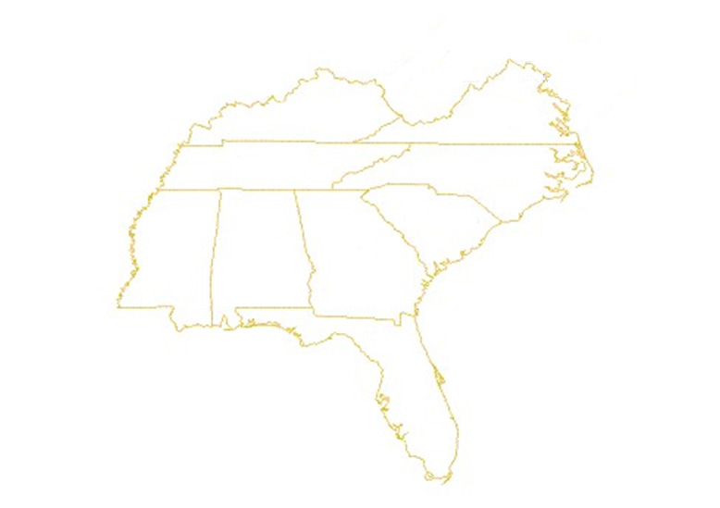






















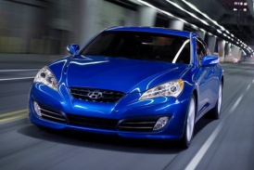


State Focus, Regional Asset
Vehicle Cluster
Center for
Advanced Vehicular Systems
www.cavs.msstate.edu

Slide 3
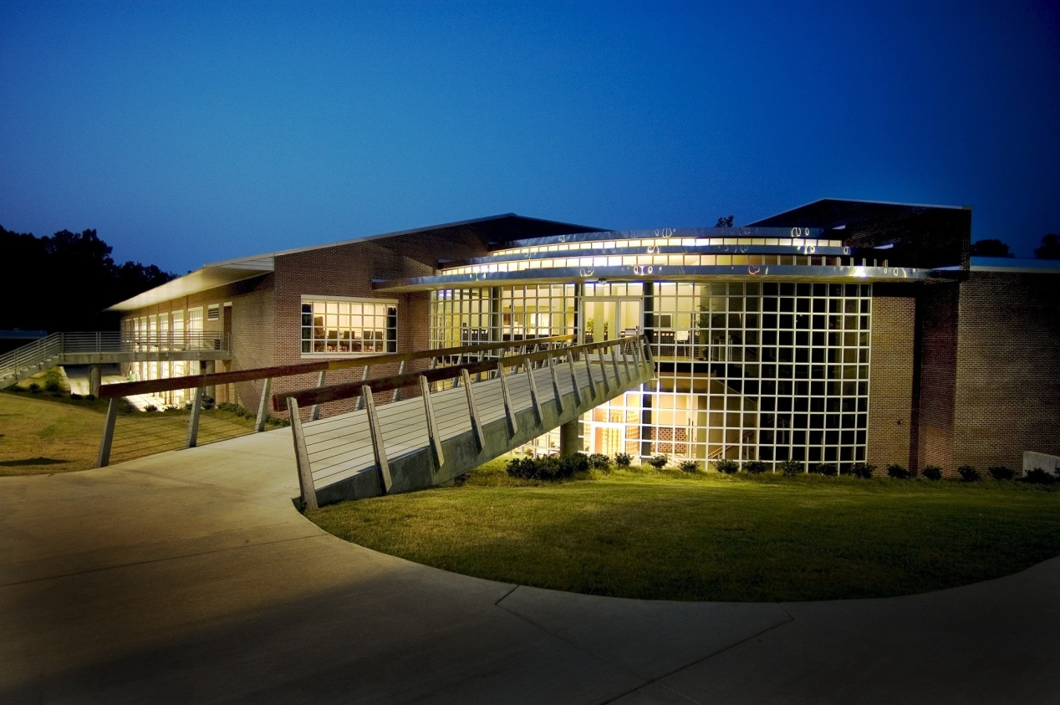
Center for Advanced Vehicular Systems
2002 $4M
2003 $6 M
2004 $9 M
2005 $12M
2006 $13M
2007 $15M
2008 $16M
2009 $18M
2010 $20.5M
2011 $23M

Slide 4
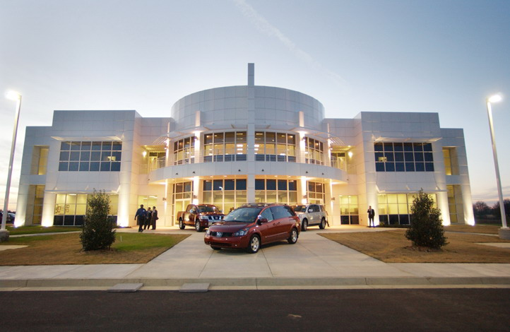

CAVS Extension Center
Canton, MS
Economic Impact: $4,363,139,531*
Amount reported from January 1, 2006 to September 30, 2009
Jobs Saved: | 353
Jobs Created: | 1,283
Cost Savings: | $2,327,700
Increased Sales: | $4,282,447,000
Retained Sales: | $7,241,531
Investment Created: | $71,123,300
*Economic Impact amounts are collected and verified by the U.S. Department of Commerce

Slide 5
Social, Economical, and Political Driving Forces for ICME
Cost savings
Lightweighting
for less emissions
and better
gas mileage
ICME
need
safety
HPC

Slide 6
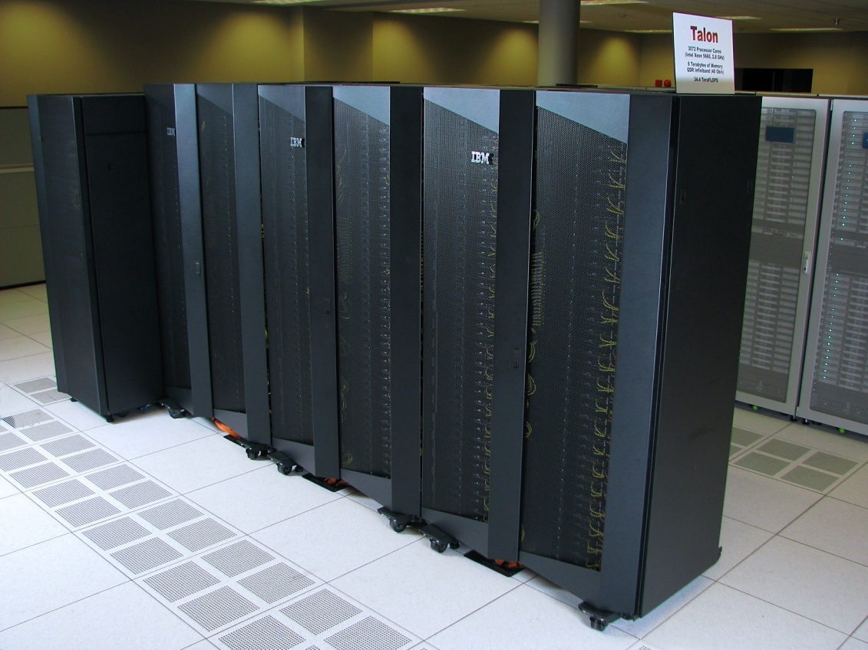
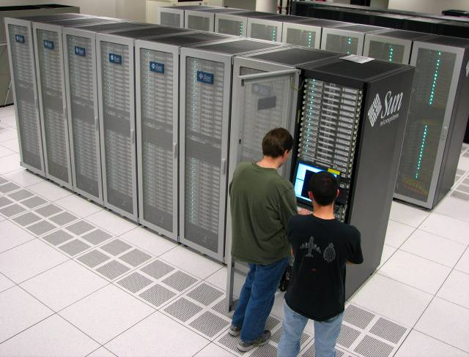

High Performance Computing
High-Performance computing systems
  Talon: 3072 processors, 6 TB RAM
  Raptor: 2048 processors, 4 TB RAM
  Matador: 512 processors, 512 GB RAM
  Maverick: 384 processors, 480 GB RAM
Storage
  250 TB of high-speed disk storage
  2 PB of near-line storage
Based on the November 2009 TOP500 list, Talon is equivalent to the 222nd fastest computer in the world and the 14th fastest computer in US academia
Based on the November 2009 Green500 list, Talon is equivalent to the 8th most energy-efficient supercomputer in the world

Slide 7
Lead Time Reduction → Simulation Based Design
Number of Problem Resolutions
Upfront Engineering
Simulation Driven Development
Design Change Cost
Digital Engineering
Design Change Cost
Conventional Design, Build, Test
Design Change Cost
Design Change Cost
Development Phase
Development Phase
Concept Design
Detail Design
Proto-typing
Evaluation
Production Ramp-Up
Full Production
Resolution Cost per problem
1 X
10 X
100 X
1000 X
20000+ X
Source: ITI (GE Aircraft Engines)

Slide 8
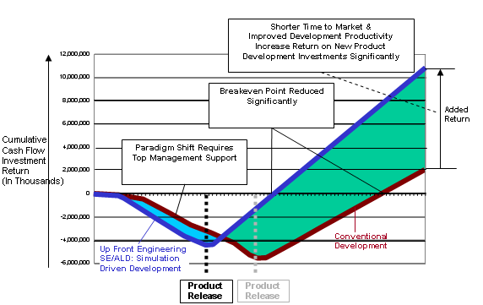
Lead Time Reduction → Simulation Based Design Cost Savings
Lead Time Reduction

Slide 9
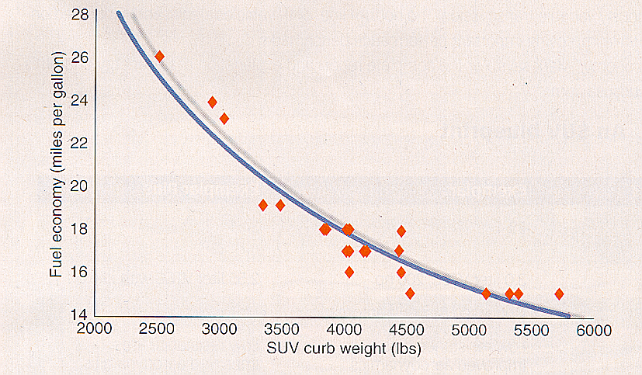
Lightweighting Designs
Economic Impact: less material
Societal Impact: less reliance on foreign oil and reduced emissions
Intellectual Impact: design methodologies with lighter materials
Feature Content
Safety
ABS
Airbags
Crash Structure
NVH
Stiffness
Insulation
Average Passenger Vehicle Weight in Pounds
Performance
4W Drive
Traction Control
Powertrain Features
Extras
Convertibles
Power Accessories
Electronics Devices
3666
3360
3059
Fuel Economy Vs. SUV Curb Weight
Model Year
Source: American Metal Market
Source: Design News 10/2/00

Slide 10
Crash
Societal Impact: the leading cause of death from ages 3-34 in the USA is auto accidents (CIREN: http://www-nrd.nhtsa.dot.gov/departments/ nrd-50/ciren/CIREN.html)
Economic Impact: Carlos Gohn, Pres. of Nissan, told MSU/CAVS to focus on Crashworthiness
Intellectual Impact: lightweight designs in crash environments
 | Yearly Economic Cost | Research Investment
Cancer | $172 Billion | $5 Billion
Heart Disease | $350 Billion | $2 Billion
Crash | $340 Billion | $200 Million
Solution: Greater research investment for safer designs, education, and virtual tools to reduce economic costs

Slide 11
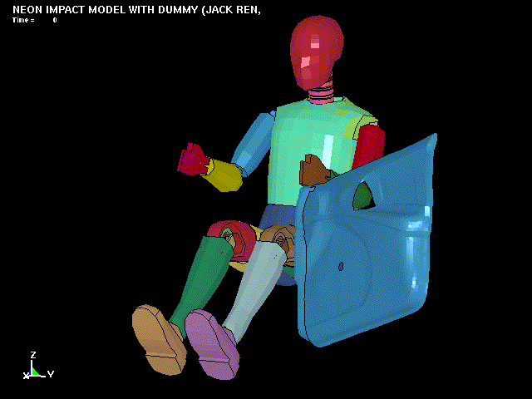
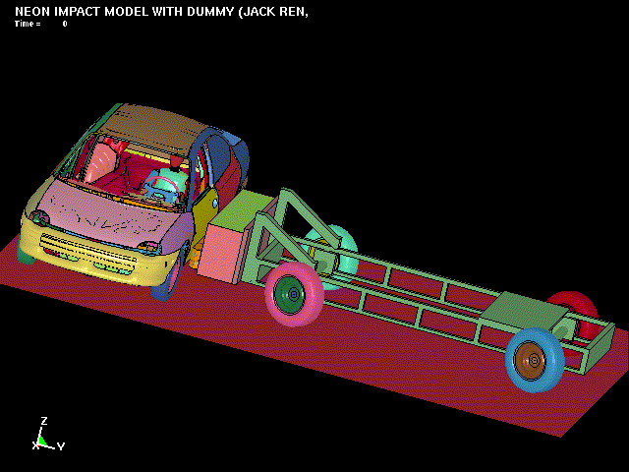
Crashworthiness and Safety

Slide 12
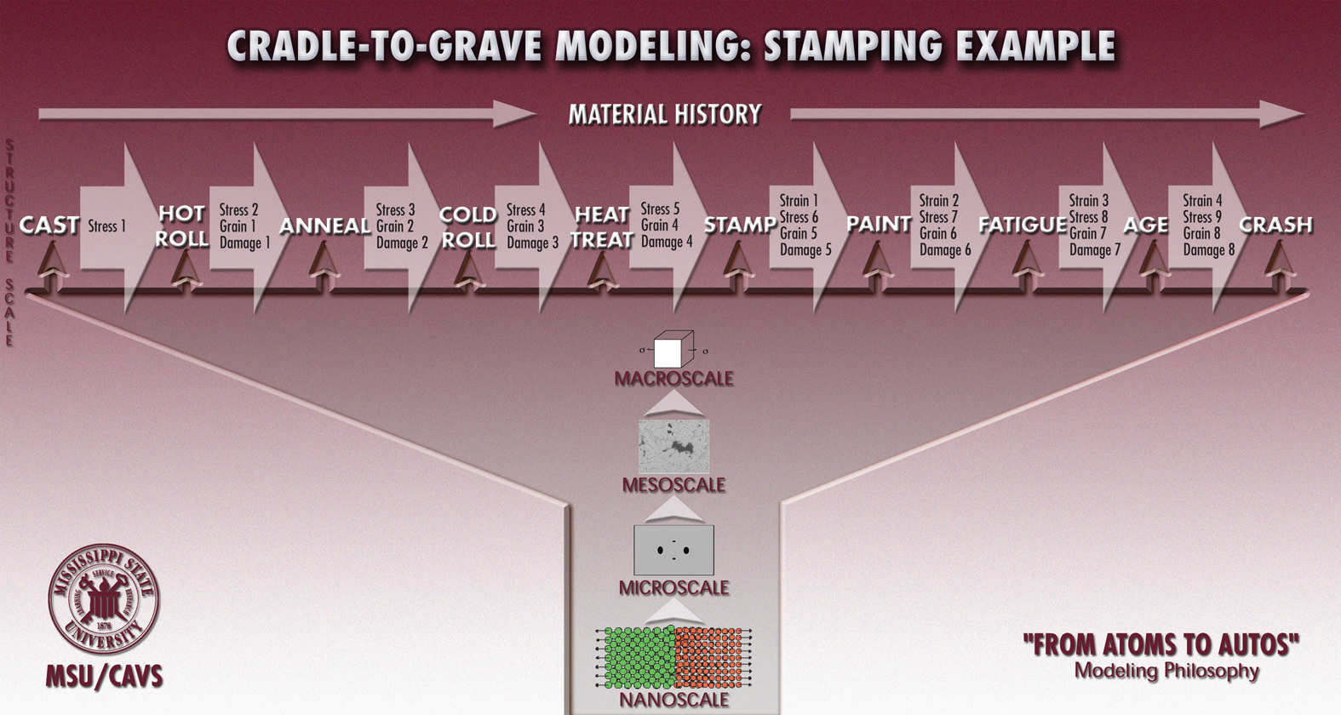
Integrated Computational Materials Engineering (ICME)
Requirements
Process-Structure-Property Modeling

Slide 13

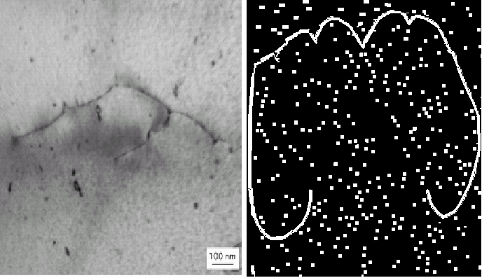
Multiscale Modeling
Bridge 12 = FEA
ISV
ISV
ISV
Bridge 11 = FEA
Macroscale ISV Continuum
Macroscale ISV Continuum
Void \ Crack
Interactions
Bridge 10 =
Void \ Crack Growth
Crystal
Plasticity
(ISV + FEA)
100-500µm
Bridge 9 =
Void \ Crack Nucleation
Bridge 5 = Particle-Void Interactions
10-100 µm
Crystal Plasticity
(ISV + FEA)
Bridge 8 =
Dislocation Motion
Bridge 4 = Particle Interactions
µm
Crystal Plasticity
(ISV + FEA)
Bridge 7 =
High Rate Mechanisms
Bridge 3 = Hardening Rules
100’s Nm
Dislocation
Dynamics (Micro-3D)
Bridge 6 =
Elastic Moduli
Bridge 2 = Mobility
Nm
Atomistics
(EAM,MEAM,MD,MS,
Bridge 1 = Interfacial Energy, Elasticity
Å
Electronics
Principles (DFT)

Slide 14
Multiscale Experiments
1. Exploratory exps
2. Model correlation exps
3. Model validation exps
Structural Scale
Experiments
FEM
Macroscale
Nanoscale
Continuum Model
Cyclic Plasticity
Damage
Experiment
Uniaxial/torsion
Notch Tensile
Fatigue Crack Growth
Cyclic Plasticity
Model
Cohesive Energy
Critical Stress
Analysis
Fracture
Interface Debonding
FEM Analysis
Torsion/Comp
Tension
Monotonic/Cyclic
Experiment
TEM
Microscale
ISV Model
Void Nucleation
Mesoscale
IVS Model
Void Growth
Void/Void Coalescence
Void/Particle Coalescence
Experiment
SEM
Optical methods
ISV Model
Void Growth
Void/Crack Nucleation
Experiment
Fracture of Silicon
Growth of Holes
FEM Analysis
Idealized Geometry
Realistic Geometry
Fem Analysis
Idealized Geometry
Realistic RVE Geometry
Monotonic/Cyclic Loads
Crystal Plasticity

Slide 15

Design Optimization
Optimization under Uncertainty
Analysis
Design Options
Product & Process Performance
(strength, reliability,
weight, cost, manufactur-ability )
Optimal
Product
Process
Product
(material, shape, topology)
Multiscales
Design Objective & Constraints
Experiment
Model
Process
(method, settings, tooling)
FEM Analysis
Environment
(loads, boundary conditions)
Cost Analysis
Preference & Risk Attitude
ISV

Slide 16
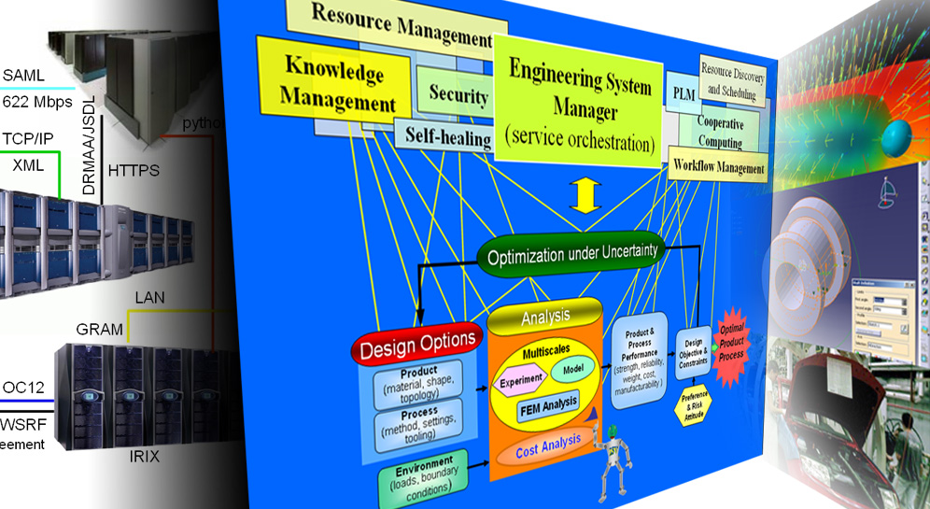
CyberInfrastructure
IT technologies
(hidden from the engineer)
Conceptual design process
(user-friendly interfaces)
Engineering tools
(CAD, CAE, etc.)
Notes:
Strategic Goal #4 Cyberinfrastructure and information systems integration (related to Thrust 4)
Create and demonstrate integrated system of information tools for rapid concurrent design of
engineered components, assemblies, and the associated manufacturing processes incorporating
associated technologies.
Objectives
1. Create and demonstrate the framework for integrating design toolkits and
computational analysis tools with multiscale materials models, including interfaces to industry standard
commercial tools.
2. Create and demonstrate common easy-to-use design environment configurable for multilevel users
with distributed, concurrent, collaborative access.
3. Create means to transparently utilize computational grid resources with distributed computational
and information resources.
4. Create and demonstrate extensible, adaptive design framework with decision support, knowledge
accumulation, and support for incorporating business cost models.
5. Create and demonstrate tools and utilities for rapidly creating rule-based applications.
The cyber-infrastructure addresses concerns/issues at various levels/layers.
At the top, are engineers and the problems they are solving (shown in the center panel above). At this layer, we are addressing issues related to user interfaces and knowledge capture & semantics.
At the second layer (from the top) we are addressing issues related to individual applications and programming of parallel codes (shown in the right panel). These applications need to be engineered so as to allow integration with other application. Knowledge representation is an issue to be addressed here.
At the third layer, we are addressing application integration and interfaces (also shown in the right panel).
At the bottom layer, we are addressing issues related to IT enabling technologies (e.g., Grids, portals, web, security) and organizational issues such as service level agreements.

Slide 17
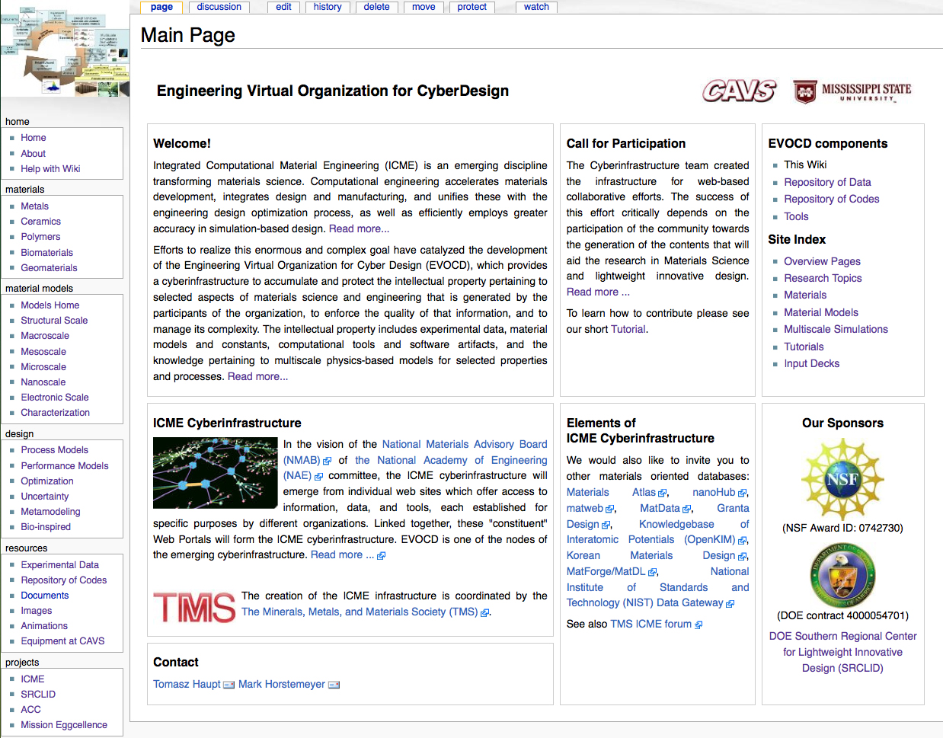

Slide 18
Can I create a
formed
component
without an
Experiment?
with multiscale
Modeling?
ISV
Bridge 12 = FEA
Macroscale ISV Continuum
Macroscale ISV Continuum
Bridge 9 =
polycrystal stress-strain behavior
Bridge 8 =
dislocation density and yield
Bridge 7 =
High Rate Mechanisms
Bridge 6 =
Elastic Moduli
Crystal Plasticity
(ISV + FEA)
µm
Bridge 3 = Hardening Rules
100’s Nm
Dislocation
Dynamics (Micro-3D)
Bridge 2 = Dislocation Mobilities
Nm
Atomistics
(EAM,MEAM,MD,MS,
Bridge 1 = Energy, Elasticity
Å
Electronics
Principles (DFT)

Slide 19
Quantify
Performance
Parameters
First!!!

Slide 20
Plasticity/Ductility

Slide 21
Start with the End in Mind: What do I need for the Macroscale
Internal State Variable Plasticity-Damage Model to address
the performance and manufacturing?
(mm-m)
Bridge 12 = material model
Macroscale ISV Continuum
Bridge 9 =
Polycrystal stress-strain behavior
Bridge 8=
Dislocation Density and Yield
(μm)
Bridge 7 =
High Rate Mechanisms
(nm)
(100 nm)
Bridge 6 =
Elastic Moduli
(Å)

Slide 22
Nanoscale: MD simulations of
Al (10-100 nm)
down
scaling:
energies
and
elastic
moduli
of
Al
needed
Bridge
up
scaling:
energies
and
elastic
moduli
of
Al
given
Electronics Scale: DFT simulations of Al (0.1-10 nm)

Slide 23
The Schrödinger Equation (1926)
Classical mechanics
Quantum mechanics
(1) Classical mechanics:
Initial conditions:

Slide 24
(2) Quantum mechanics
Wave function
Schrödinger Equation

Slide 25
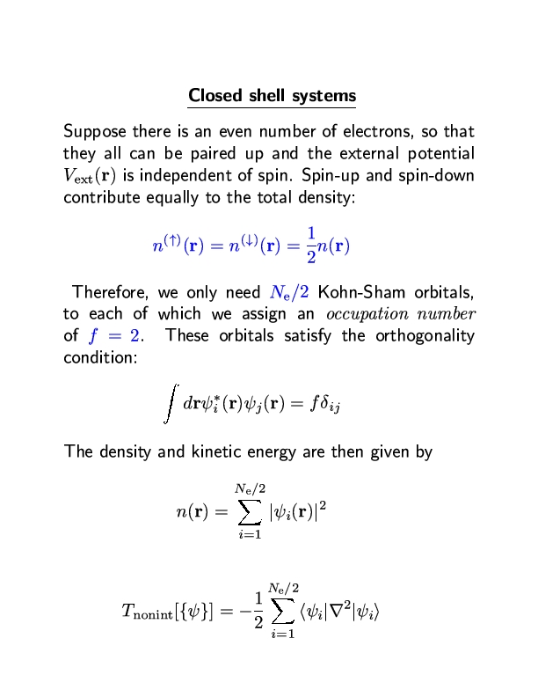
Basis for the
Density Functional
Theorem (DFT)

Slide 26
Macroscale ISV Constitutive Equation
Bridge 7=
High Rate Mechanisms
Dislocation Dynamics (DD)
Bridge 2 = dislocation mobilites
Nm
Atomistic Simulations
(EAM,MEAM,MD,MS)
Bridge 1 = Interfacial Energy, Elasticity
Electronics
Principles (DFT)

Slide 27
Energy: Embedded Atom Method (EAM)
  Total energy E
  F ^{i} : embedding energy of atom i
  ρ ^{i} : electronic density of atom i
  r ^{ij} : separation distance between atom i and j
  φ ^{ij} : pair potential of atom i and j
Molecular Dynamics (f=ma, finite temperatures)
Molecular Statics (rate independent, absolute zero)
Monte Carlo Simulations (quasi-static, finite temperatures)

Slide 28
electrons
Energy (U)
r
1/r¹²
core
Repulsion
Radius (r)
distance
between
atoms
e
r
Attraction
1/r⁶
atoms

Slide 29
Determination of Atomic Stress Tensor
(Daw and Baskes, 1984, Phys. Rev)
Embedded Atom Method (EAM) and Modified Embedded Atom Method (MEAM) potentials
Local force determined from energy
Dipole Force Tensor (virial stress) is determined from local forces
Note: the difference between EAM and MEAM is an added degree of angular rotations that
affect the electron density cloud . For EAM, this quantity is simply a scalar, but for MEAM it
includes three terms that are physically motivated:

Slide 30
Summary of values for the constants for aluminum for the EAM/MEAM potentials.

Slide 31
Comparison of DFT and MEAM calculations for Aluminum illustrating the Bridging Results
MEAM found fcc to have lowest energy
MEAM equilibrium volumes are close to ab-initio DFT results

Slide 32
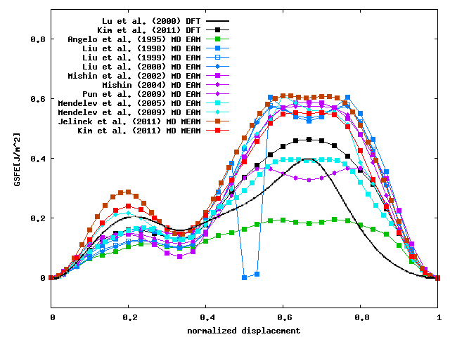
Comparison of DFT with EAM and MEAM potential results for the
Generalized Stacking Fault Energy Curves

Slide 33
Mesoscale: forest hardening from DD simulations of Al (100 nm-1 μm)
down
scaling:
dislocation
mobility
values
Bridge
up
scaling:
edge
and screw
dislocation
drag
coefficients
Nanoscale: MD simulations of
Al (10-100 nm)

Slide 34
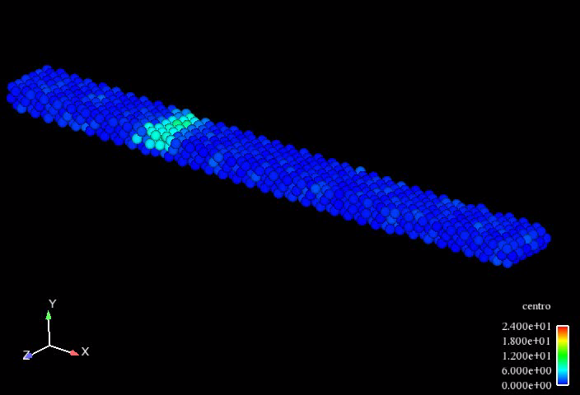
Dislocation moving in Al to quantify the velocity for DD sims

Slide 35
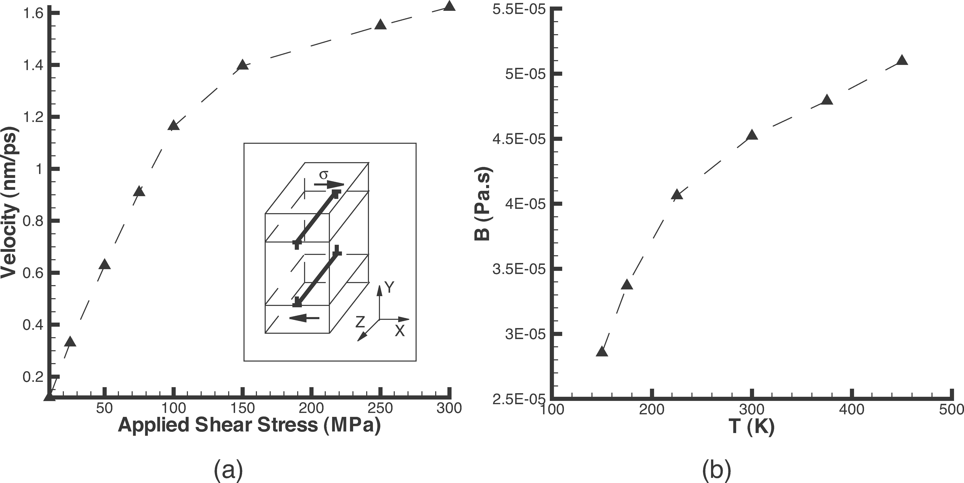
Atomistic Simulations of Aluminum with an Edge Dislocation
dislocation
velocity
drag coefficient

Slide 36
Macroscale ISV Constitutive Equations
Bridge 8= dislocation density and yield
Crystal Plasticity Simulations
Bridge 3 = Hardening Rules
Dislocation Dynamics
Simulations
µm
Bridge 2 = Dislocation Mobilities
Atomistic Simulations

Slide 37
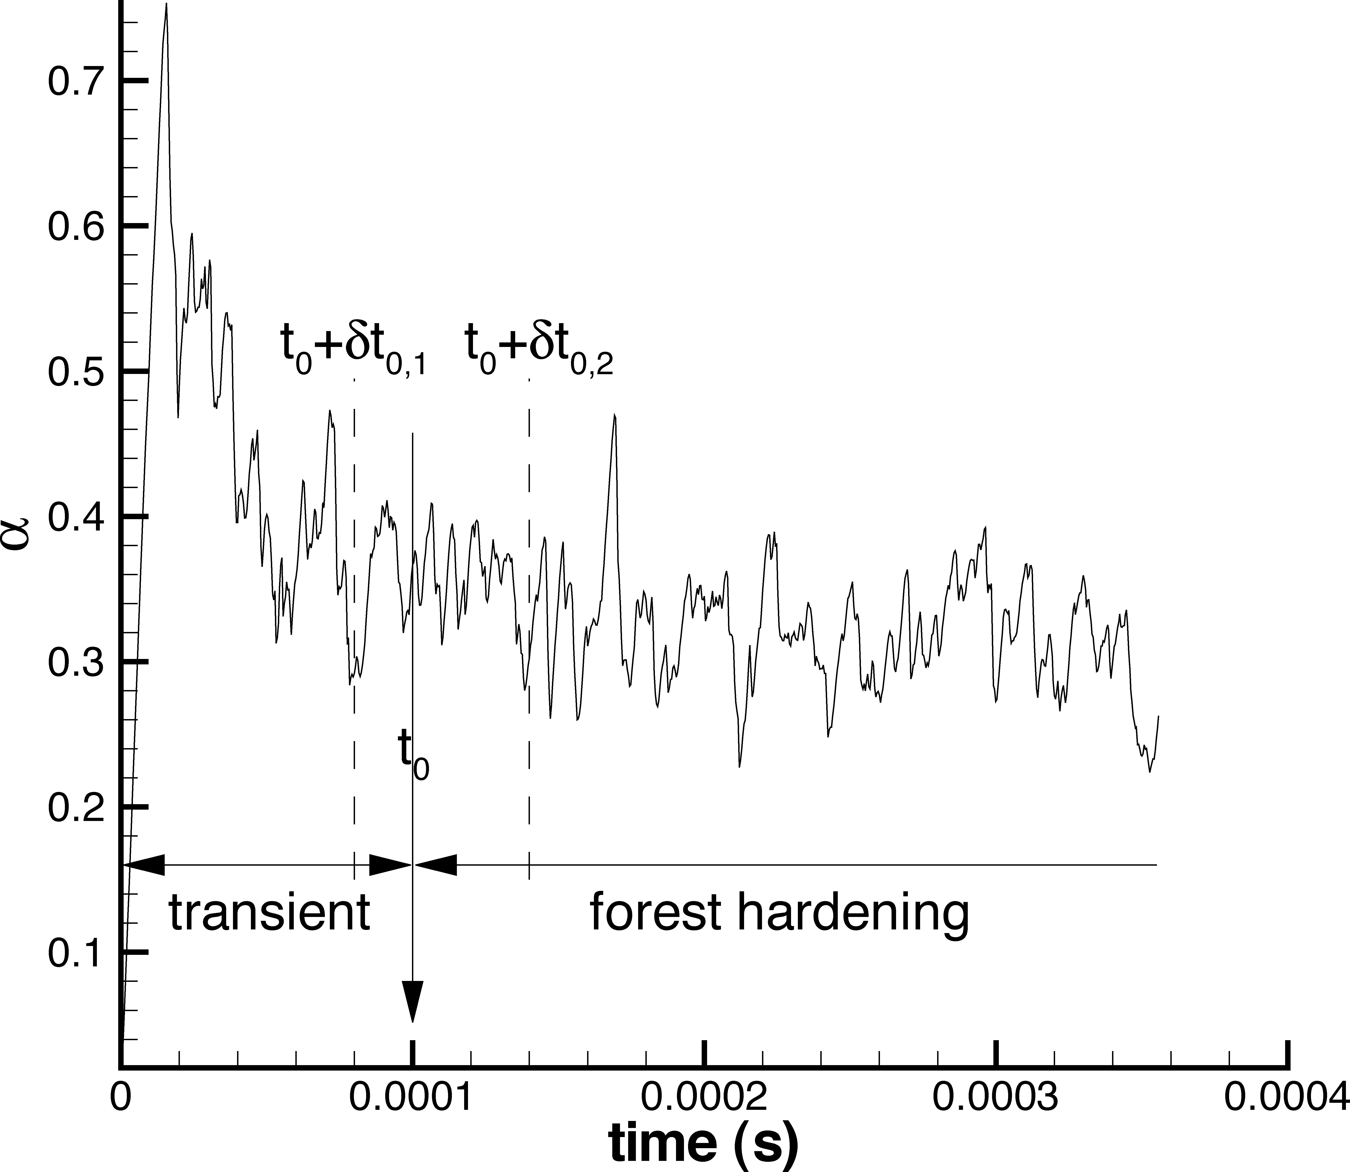
DD simulation result of the dislocation junction strength, α
dislocation junction
strength
dislocation hardening

Slide 38
Mesoscale: crystal plasticity polycrystalline Al simulations
(1-200 μm)
down
scaling:
single
crystal
hardening
rule
Bridge
up
scaling:
constants
for
hardening
rule
Microscale: DD simulations of
Al (100 nm- 1 μm)

Slide 39
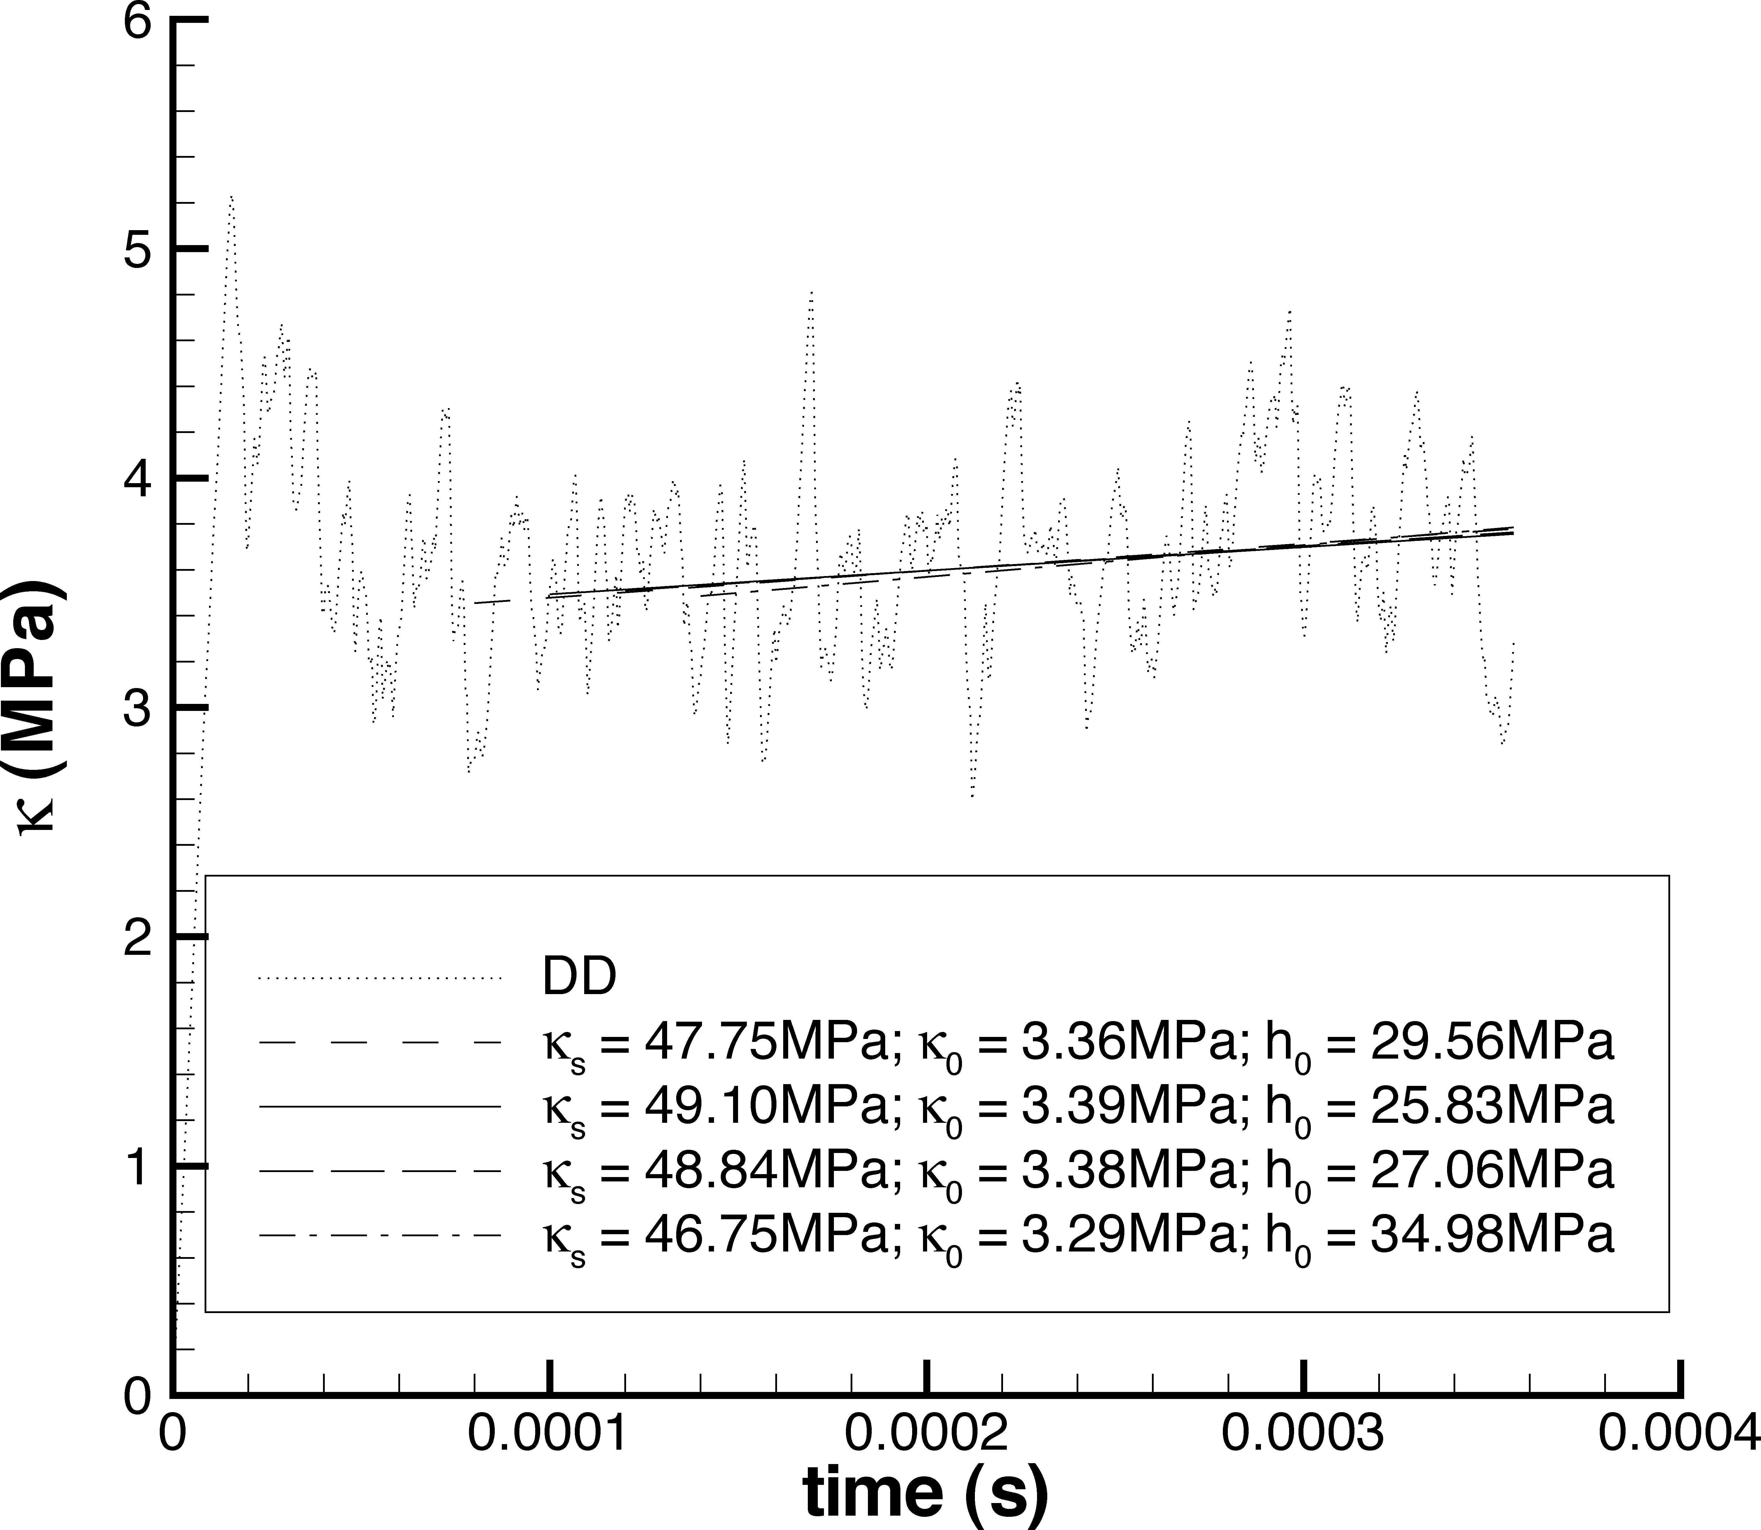
DD results for the hardening rule to be used in Crystal Plasticity (CP)
Voce Hardening Eqtn
Plastic shear
rate determined
from DD sims
hardening constants determined
from DD sims

Slide 40
Macroscale ISV Constitutive Equations
Bridge 9 =
Polycrystal stress-strain behavior
Crystal Plasticity Simulations
µm
Bridge 3 = Hardening Rules
Dislocation Dynamics Simulations

Slide 41
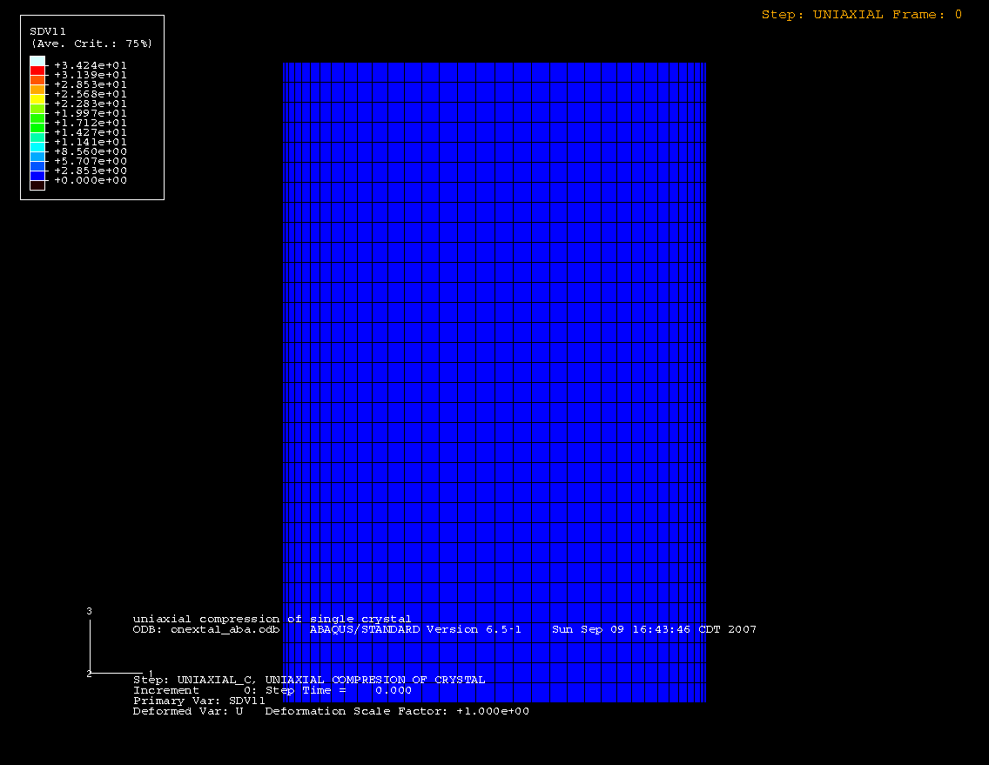
CP single crystal simulation of Al using the DD hardening constants

Slide 42
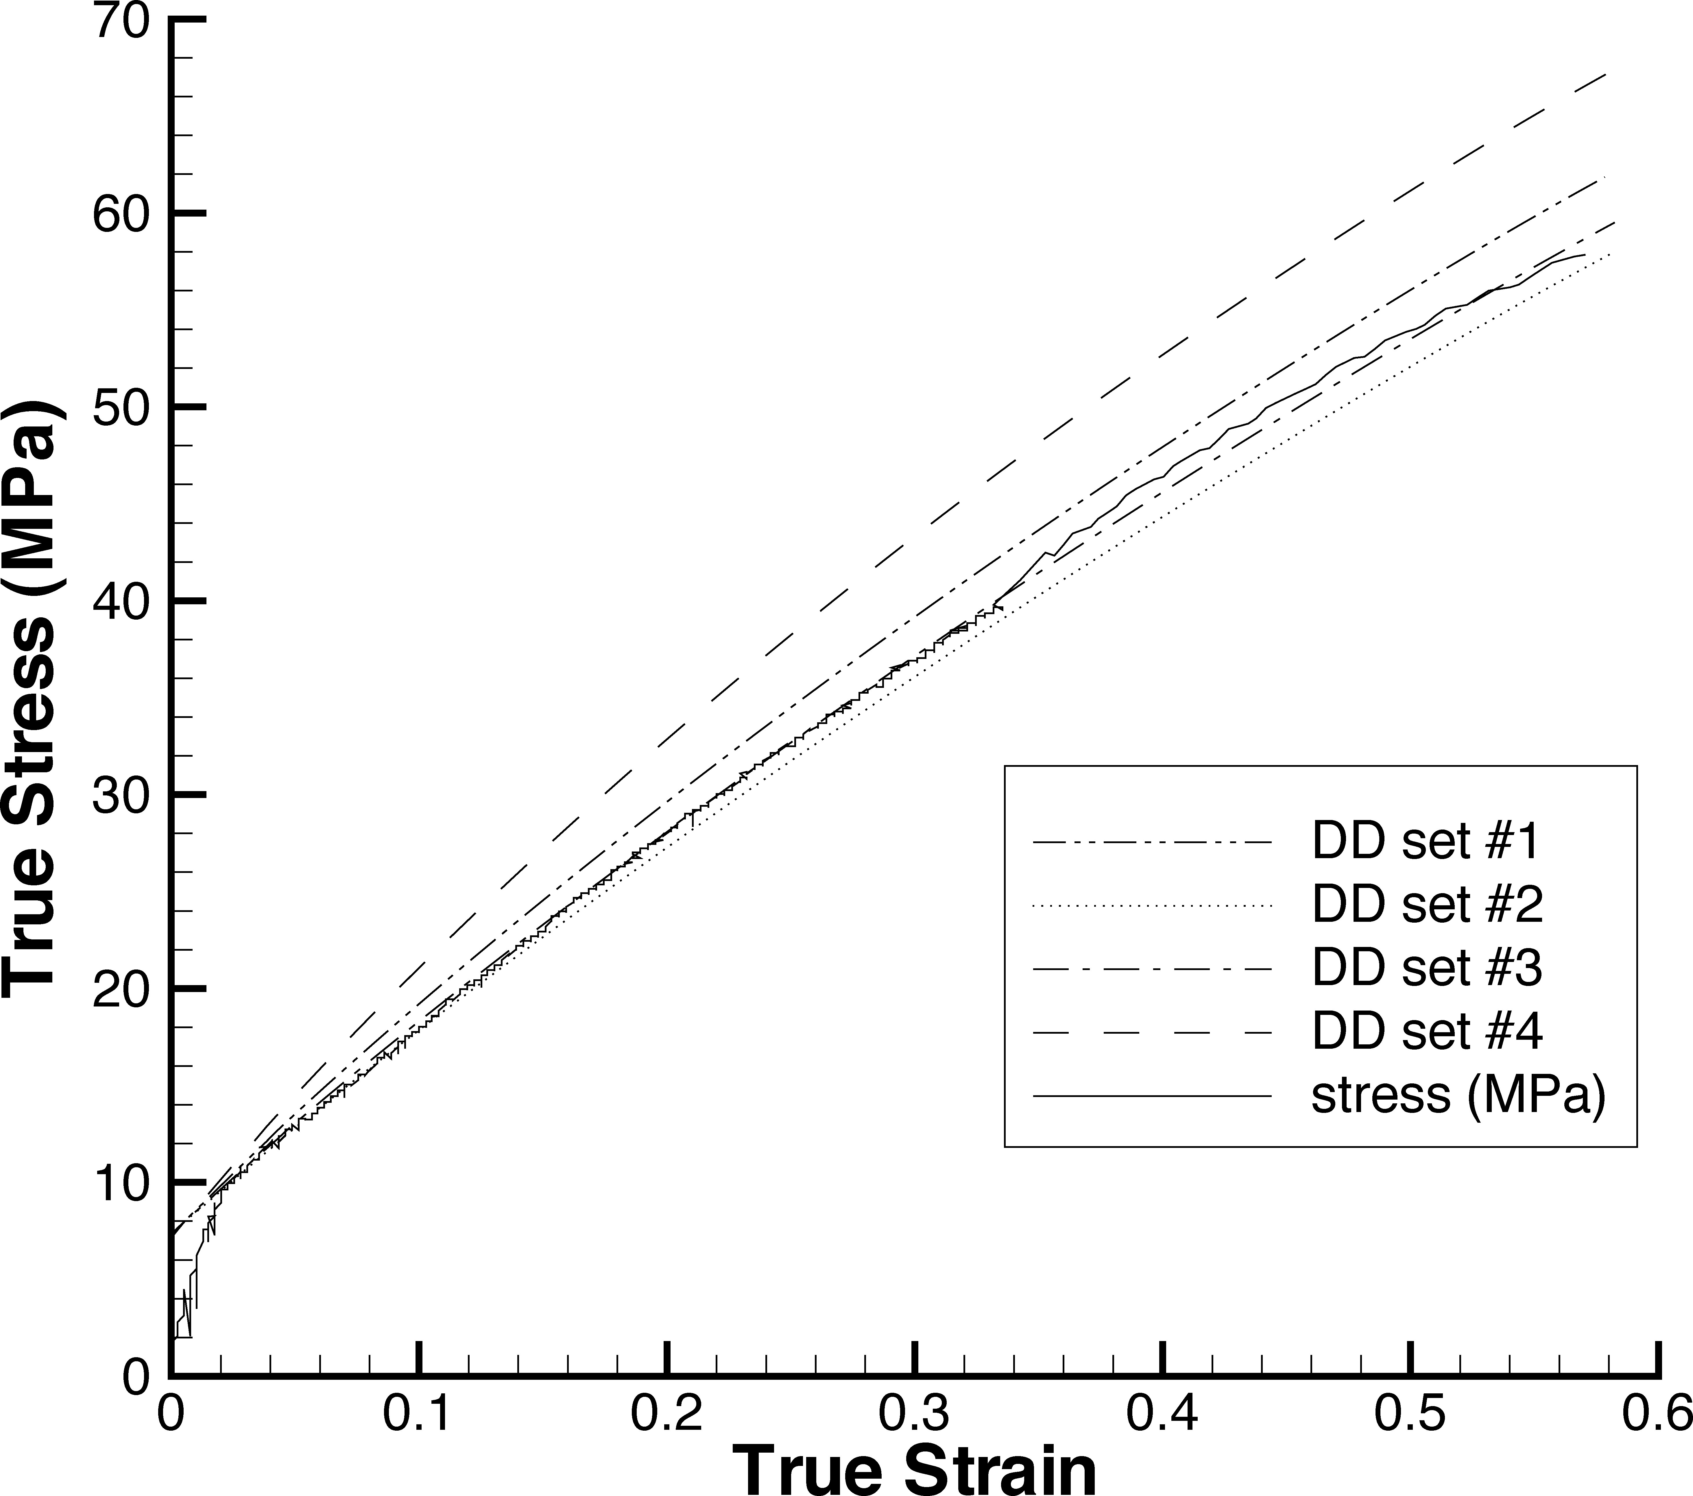
CP Stress-Strain Behavior of Single Crystal Al using four sets of DD constants
uncertainty
band
experiment

Slide 43
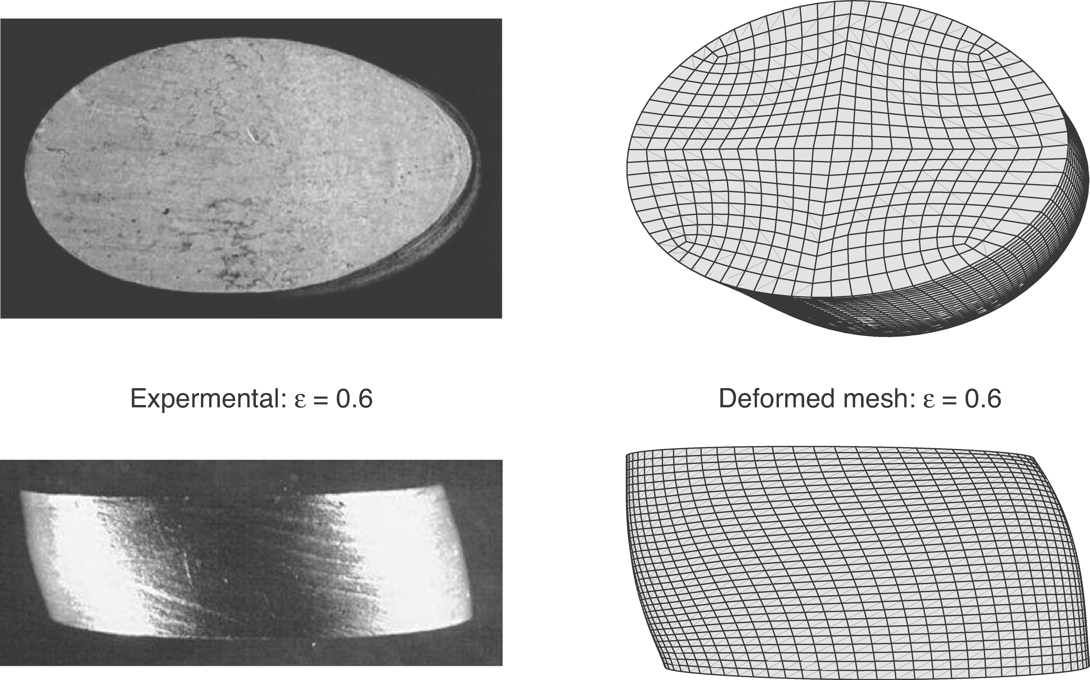
Comparison of Experimental and CP simulation results for a single crystal

Slide 44
Macroscale:
Continuum Point (mm)
down
scaling:
Stress-
strain
behavior
Bridge
up
scaling:
Polycrystal
Stress-
Strain
curves
Microscale: Crystal Plasticity
(1-20 μm)

Slide 45
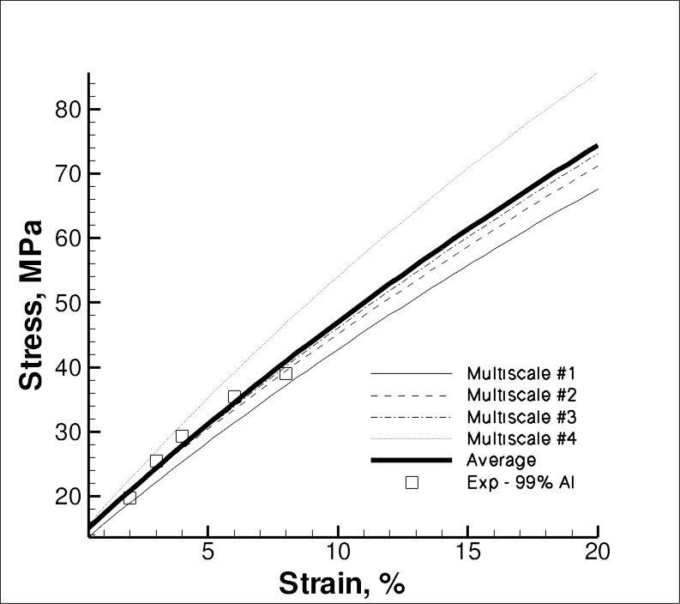
Polycrystalline CP calculations with 180 grains with the four
DD constant sets using the volume average
Note: σ-ε curve without an exp!!!

Slide 46
Macroscale Internal State Variable Plasticity-Damage Model
Downscaling Requirements
(mm-m)
Bridge 12 = material model
Macroscale ISV Continuum
Bridge 9 =
Polycrystal stress-strain behavior
Bridge 8=
Dislocation Density and Yield
(μm)
Bridge 7 =
High Rate Mechanisms
(nm)
(100 nm)
Bridge 6 =
Elastic Moduli
(Å)

Slide 47
Governing Equations
What is a constitutive relation? A mathematical description of material behavior
To satisfy continuum theory relating stress and strain (in a solid mechanics sense)
Equilibrium
Conservation of Mass
Balance of Momentum (angular and linear)
Balance of Energy (1st Law of Thermo)
Too many unknowns for the
number of equations, need
another equation
Constitutive relation
Internal state variable theory
materials science
2nd Law of Thermo
Microstructure-property relations
mechanics

Slide 48
Macroscale Internal State Variable Plasticity-Damage Microstructure-Property Model Equations
Damage
Dislocation-plasticity internal state variables
Dimensionless grain size
Damage internal state variables
Grain size
Particle size
Damage rate
Particle Volume fraction
Nearest neighbor distance
Dimensionless grain size

Slide 49
Macroacale ISV DMG-Plasticity Parameters
 | Average | Lower Bound | Upper Bound
Young’s Modulus | 68970 | 68970 | 68970
Poisson’s Ration | 0.33 | 0.33 | 0.33
c01 | 0. | 0. | 0.
c02 | 1. | 1. | 1.
c03 | 9.12 | 8. | 9.12
c04 | 161.7 | 161.7 | 161.7
c05 | 0.00001 | 0.00001 | 0.00001
c06 | 1. | 1. | 1.
c07 | 1. | 1. | 1.
c08 | 0. | 0. | 0.
c09 | 0. | 0. | 0.
c10 | 0. | 0. | 0.
c11 | 0. | 0. | 0.
c12 | 0. | 0. | 0.
c13 | 0.0136 | 0.012 | 0.0136
c14 | 0.08855 | 0.08855 | 0.08855
c15 | 193 | 188 | 225
c16 | 0. | 0. | 0.
c17 | 0. | 0. | 0.
c18 | 0. | 0. | 0.
c19 | 0. | 0. | 0.
c20 | 0. | 0. | 0.
c21 | 0. | 0. | 0.

Slide 50
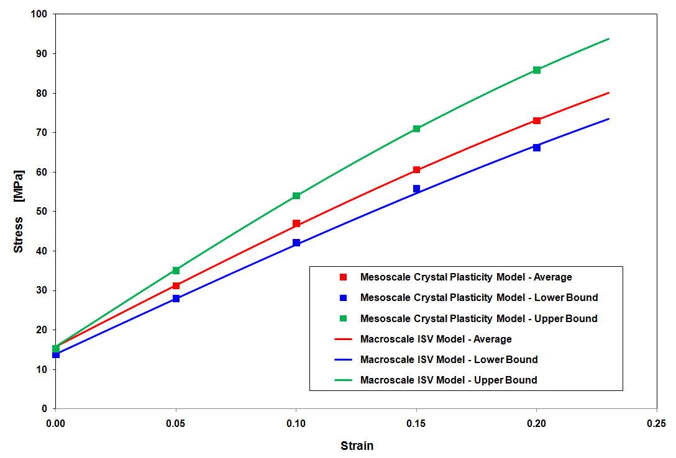
Macroscale ISV Model calibrated with Mesoscale
Crystal Plasticity Results
uncertainty
bands

Slide 51
Structural Scale: FEA of forming (m)
down
scaling:
material
model
Bridge
up
scaling:
validated
and
verified
material
model
Macroscale (mm)

Slide 52
Finite Element Analysis of Forming : Set Up
(Aluminum)

Slide 53
Structural Scale Finite Element Simulations of Forming Using the Macroscale ISV Model from the Multiscale Analysis showing the thickness changes

Slide 54
Structural Scale Finite Element Simulations of Forming Using the Macroscale ISV Model from the Multiscale Analysis showing the plastic strains

Slide 55
Structural Scale Finite Element Simulations of Forming Using the Macroscale ISV Model from the Multiscale Analysis showing the damage

Slide 56
Can I create a
formed
component
without an
Experiment?
with multiscale
Modeling?
ISV
Bridge 12 = FEA
Macroscale ISV Continuum
YES
&
YES!!
Macroscale ISV Continuum
Bridge 9 =
polycrystal stress-strain behavior
Bridge 8 =
dislocation density and yield
Bridge 7 =
High Rate Mechanisms
Bridge 6 =
Elastic Moduli
Crystal Plasticity
(ISV + FEA)
µm
Bridge 3 = Hardening Rules
100’s Nm
Dislocation
Dynamics (Micro-3D)
Bridge 2 = Dislocation Mobilities
Nm
Atomistics
(EAM,MEAM,MD,MS,
Bridge 1 = Energy, Elasticity
Å
Electronics
Principles (DFT)

Slide 57
Integrated Computational Materials Engineering (ICME)
Requirements
Process-Structure-Property Modeling

Slide 58
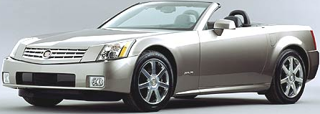
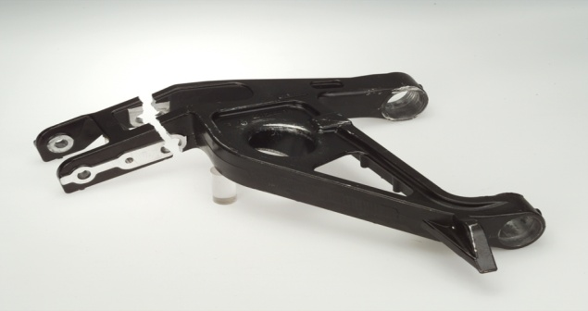
GM CADILLAC CONTROL
ARM LIGHTWEIGHT DESIGN
(2000)
Objective: To employ multiscale material modeling
to reduce the weight of components
B
C
D
E
Wrong!
A
Truth!
Standard FEA
Stress
(from highest
to lowest)
D
A
C
E
B
Inclusion
(from most severe
to less severe)
B
E
A
D
C
Damage
(from most severe
to less severe)
A
D
E
C
B
model
Region 1
Region 3
(a)
initial failure site
Result: To optimize a redesign such that
25% weight saved
50% increase in load-bearing capacity
100% increase in fatigue life
$2 less per part
(b)
experiment

Slide 59
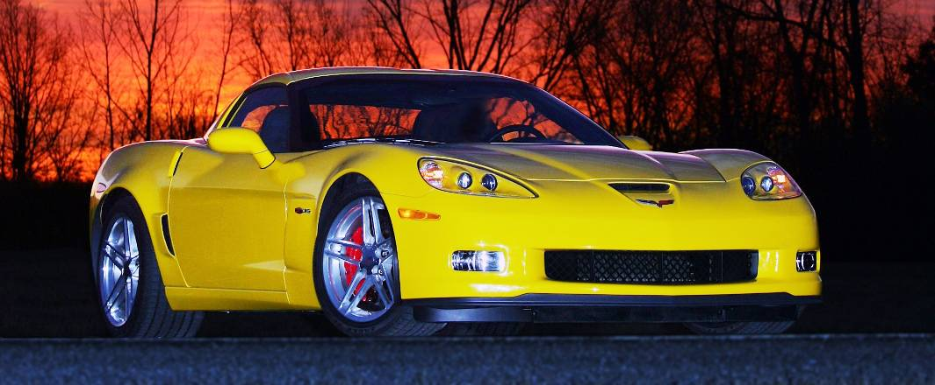
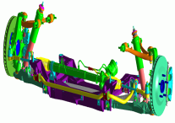
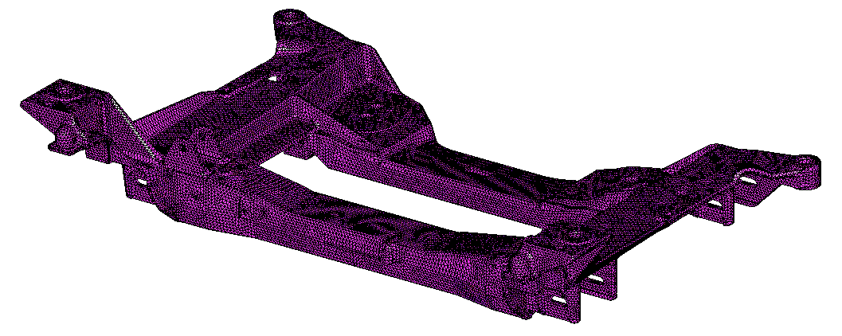
GM Corvette Cradle
Magnesium Design (2005)
System
Subsystem
Component
Internal State Variable
Plasticity-Damage
Simulation
Structures
Pore size
Nearest Neighbor Distance
Dendrite Cell Size
Porosity
Boundary Conditions
Panic brake
Pothole strike
Forces
Moments

Slide 60
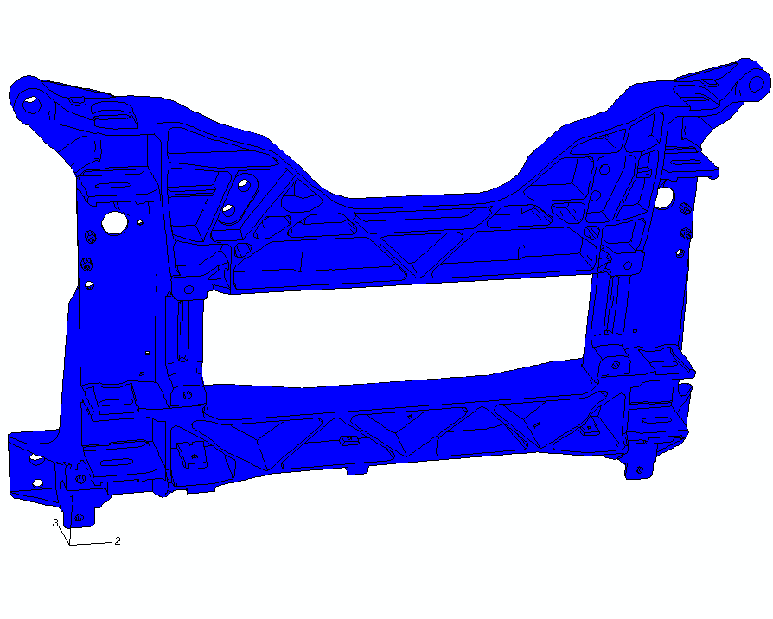
Cradle Load-to-Failure
Simulation Results
E
D
C
B
A
eddy@dissertationservices.org
F
Modern FEA answer
Modern Materials Science answer
True answer

Slide 61
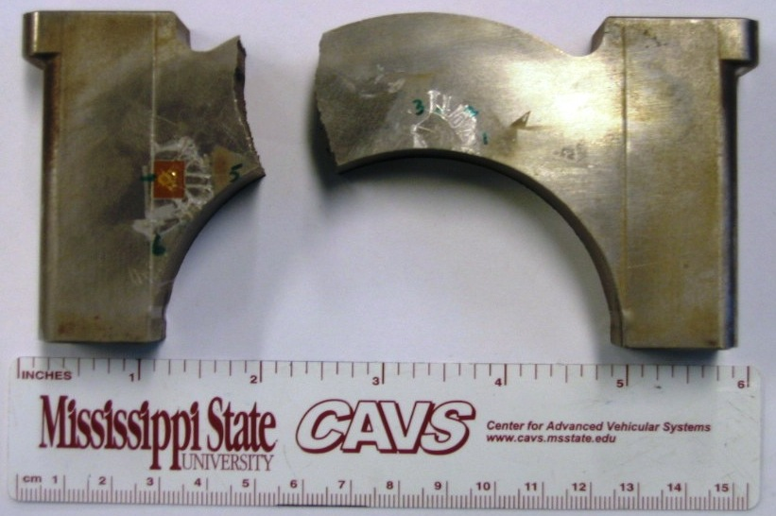
Powder Metal FC0205 Steel (2008)
Compaction, Sintering, and Performance
model
experiment
failure predicted by damage model under performance with distribution of initial porosity
Note: standard FEA would
have given the wrong location
maximum von Mises Stress

Slide 62
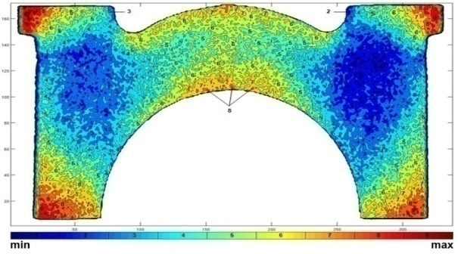
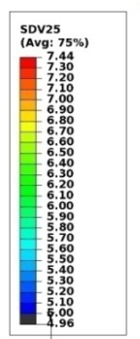
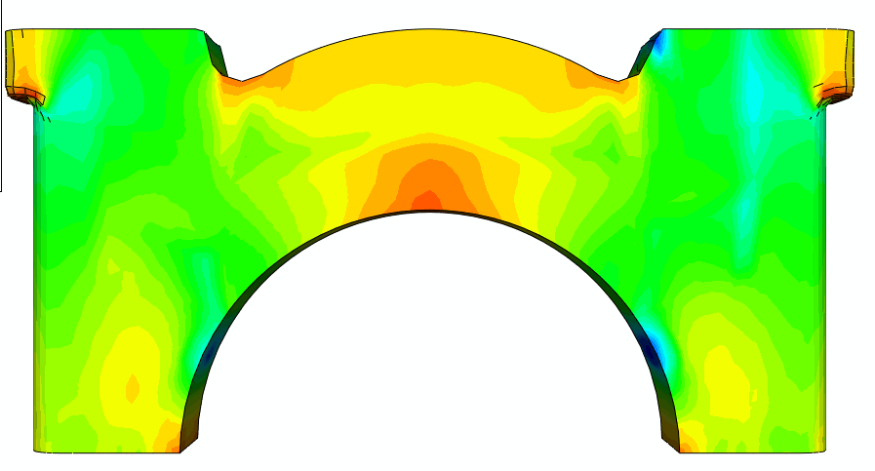
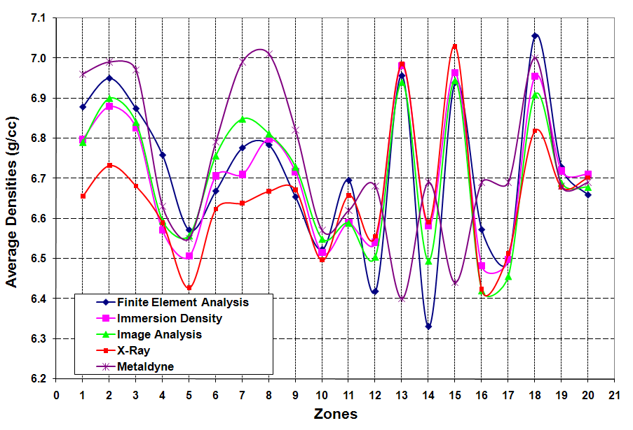
I – Compaction Modeling (Validation)
Main Bearing Cap – Green Density Distribution- after Springback (g/cc)
FEA Model
Geometry and Material Solution imported from ABAQUS/ Explicit to ABAQUS/Standard for Elastic Springback Analysis
Experiment
X-ray CT
Volume grows 0.6%
after springback
density
2D X-Ray CT
FEA 205Q
Experiment
Immersion and Image Analysis Densities by Zone
Density (g/cc)
+7.05
13
15
+7.00
12
16
1
2
3
17
14
+6.95
7
18
8
+6.90
5
6
9
10
+6.85
19
20
4
11
+6.80
Density Immersion
+6.75
+6.70
+6.65
13
1
2
3
15
+6.60
12
16
18
17
14
+6.55
7
8
9
+6.50
5
6
10
+6.45
19
4
Image Analysis
11
20
+6.40

Slide 63

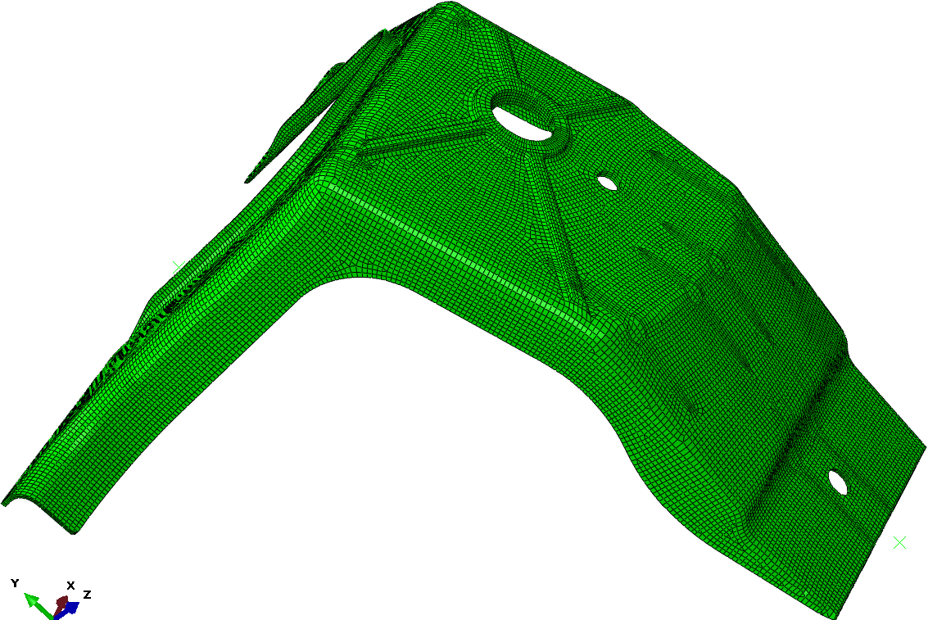
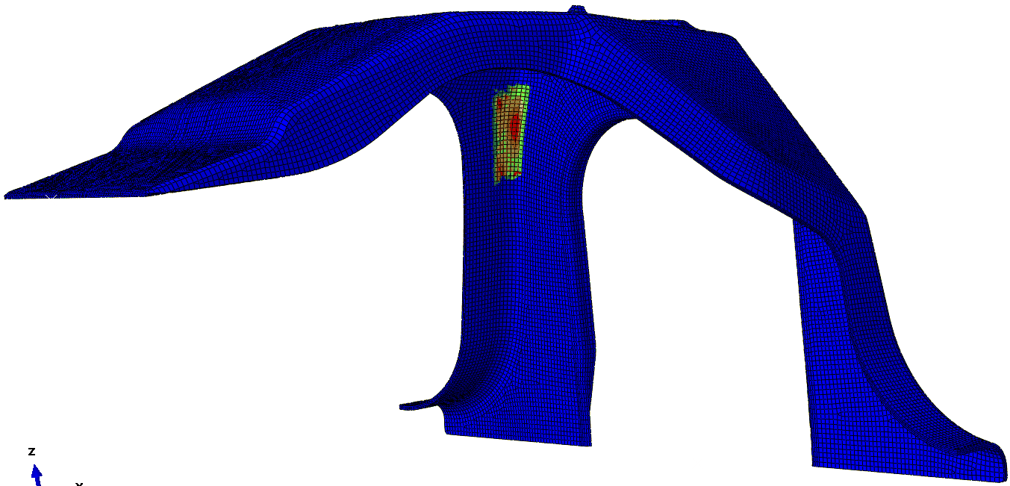
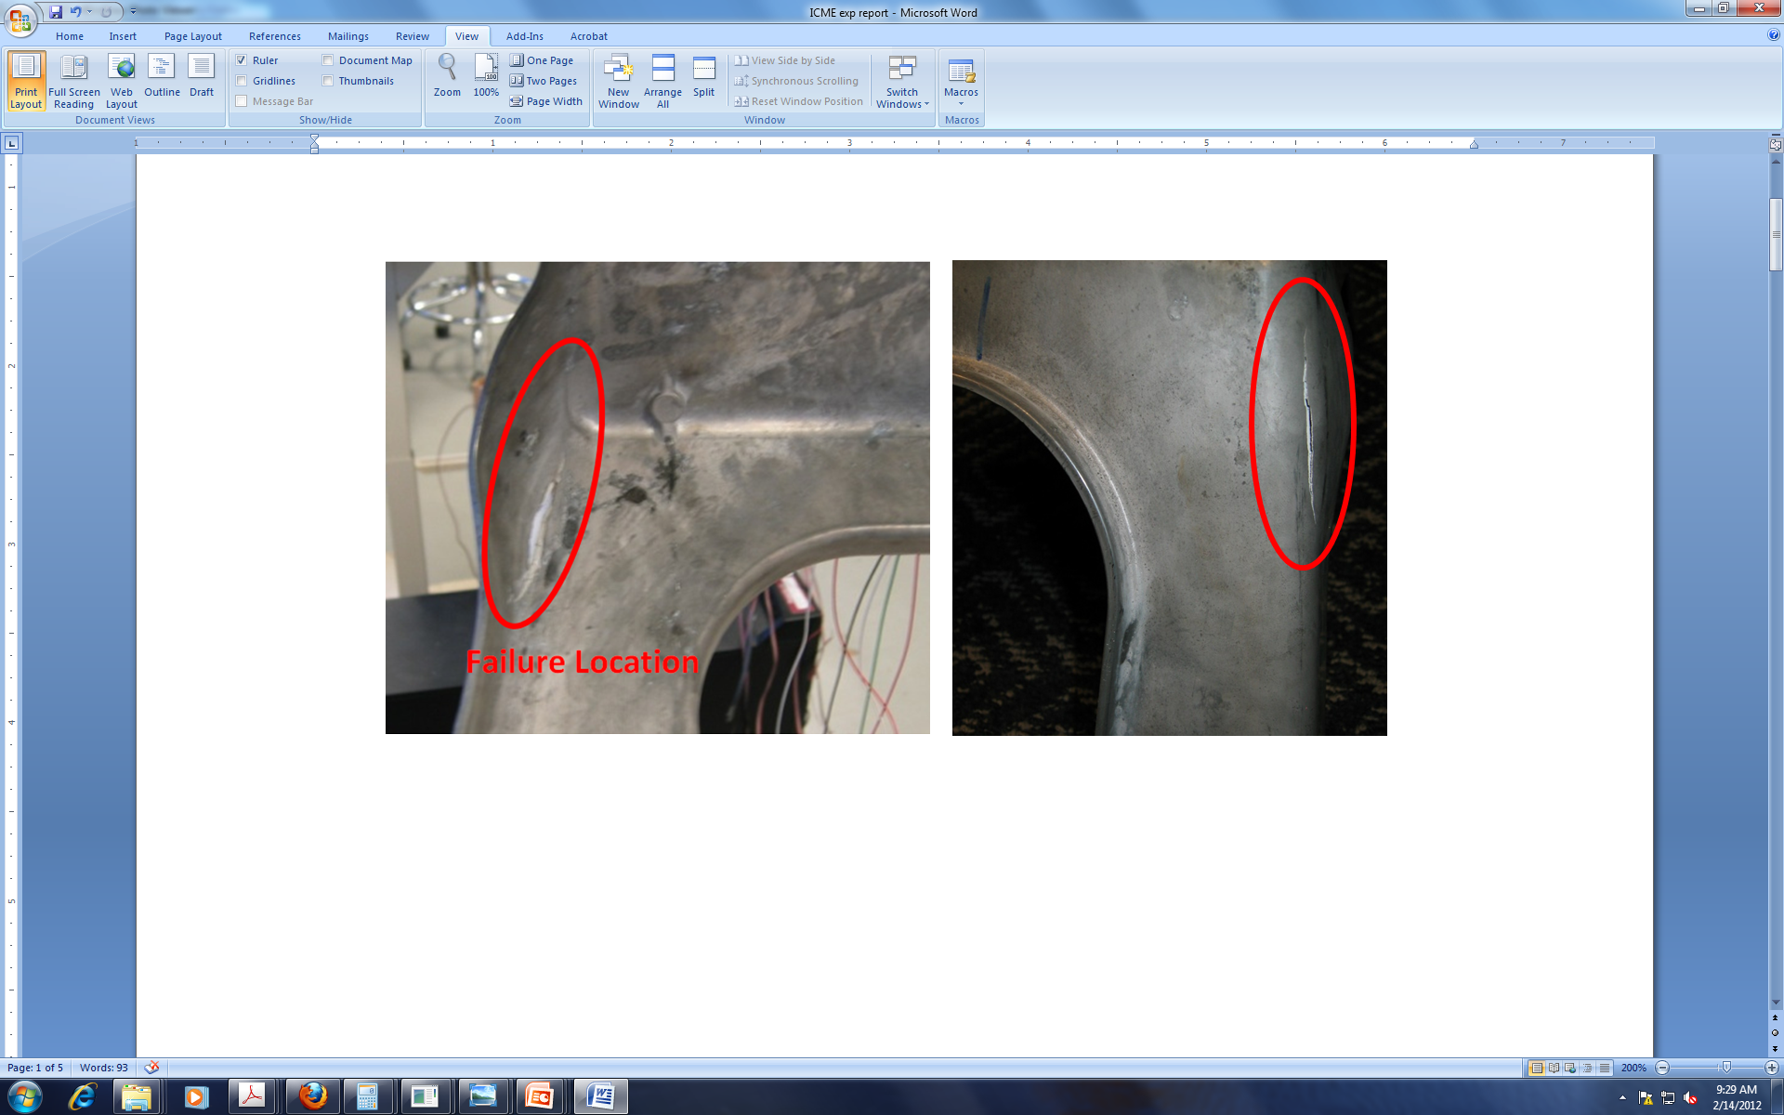

  ICME-Mg AZ91 Demo Cast (2011)
Highest initial porosity
FAILURE
Mises Stress | Initial Porosity | Damage
C | B | A
A | D | C
B | A | D
D | C | B
Highest
B
A
C
D
Lowest
Highest Von Mises stress
Standard FEA answer
Truth
Standard Materials Science answer
Failure location AND load-displ curve predicted accurately

Slide 64
ICME Tools bring in History Dependence and Multiscale Aspects

