Slide 1
Bridge 12 = material model
Macroscale ISV Continuum
Macroscale MSF Model
Bridge 10 =
MSC Growth
Bridge 9=
Crack Incubation
10-100 µm
Crystal Plasticity
(ISV + FEA)
Bridge 7 =
crack tip driving force
100’s Nm
Crystal Plasticity
(ISV + FEA)
µm
Nm
Atomistics
(EAM,MEAM,MD,MS)

Slide 2
Macroscale:
Continuum Point (mm)
down
scaling:
Grain size
effect on
MSC
regime
Bridge
up
scaling:
Grain size
parametric
effects
Mesoscale 1: realistic particles and pores in FEA (10-100 μm)

Slide 3
Macroscale:
Continuum Point (mm)
down
scaling:
Grain
orientation
effect on
MSC
regime
Bridge
up
scaling:
Schmid
Factor
effects
Mesoscale 1: realistic particles and pores in FEA (10-100 μm)

Slide 4
Macroscale:
Continuum Point (mm)
down
scaling:
Crack
incubation
plasticity
Bridge
up
scaling:
Nonlocal
plasticity
parameter
for
incubation
Microscale: DOE FEA with particles (1-20 μm)

Slide 5
Macroscale:
Continuum Point (mm)
down
scaling:
Crack tip
driving
force
parameter
Bridge
up
scaling:
MSC
ΔCTD
coefficient
Nanoscale: MD simulations of
Al (10-100 nm)

Slide 6
Macroscale MSF Model
Bridge 7 =
Crack tip
driving force
Nm
Atomistic Simulations
(EAM,MEAM,MD,MS)

Slide 7
Macroscale MSF Model
Bridge 9=
Crack
Incubation
Microscale Crystal Plasticity
(ISV + FEA)
µm

Slide 8
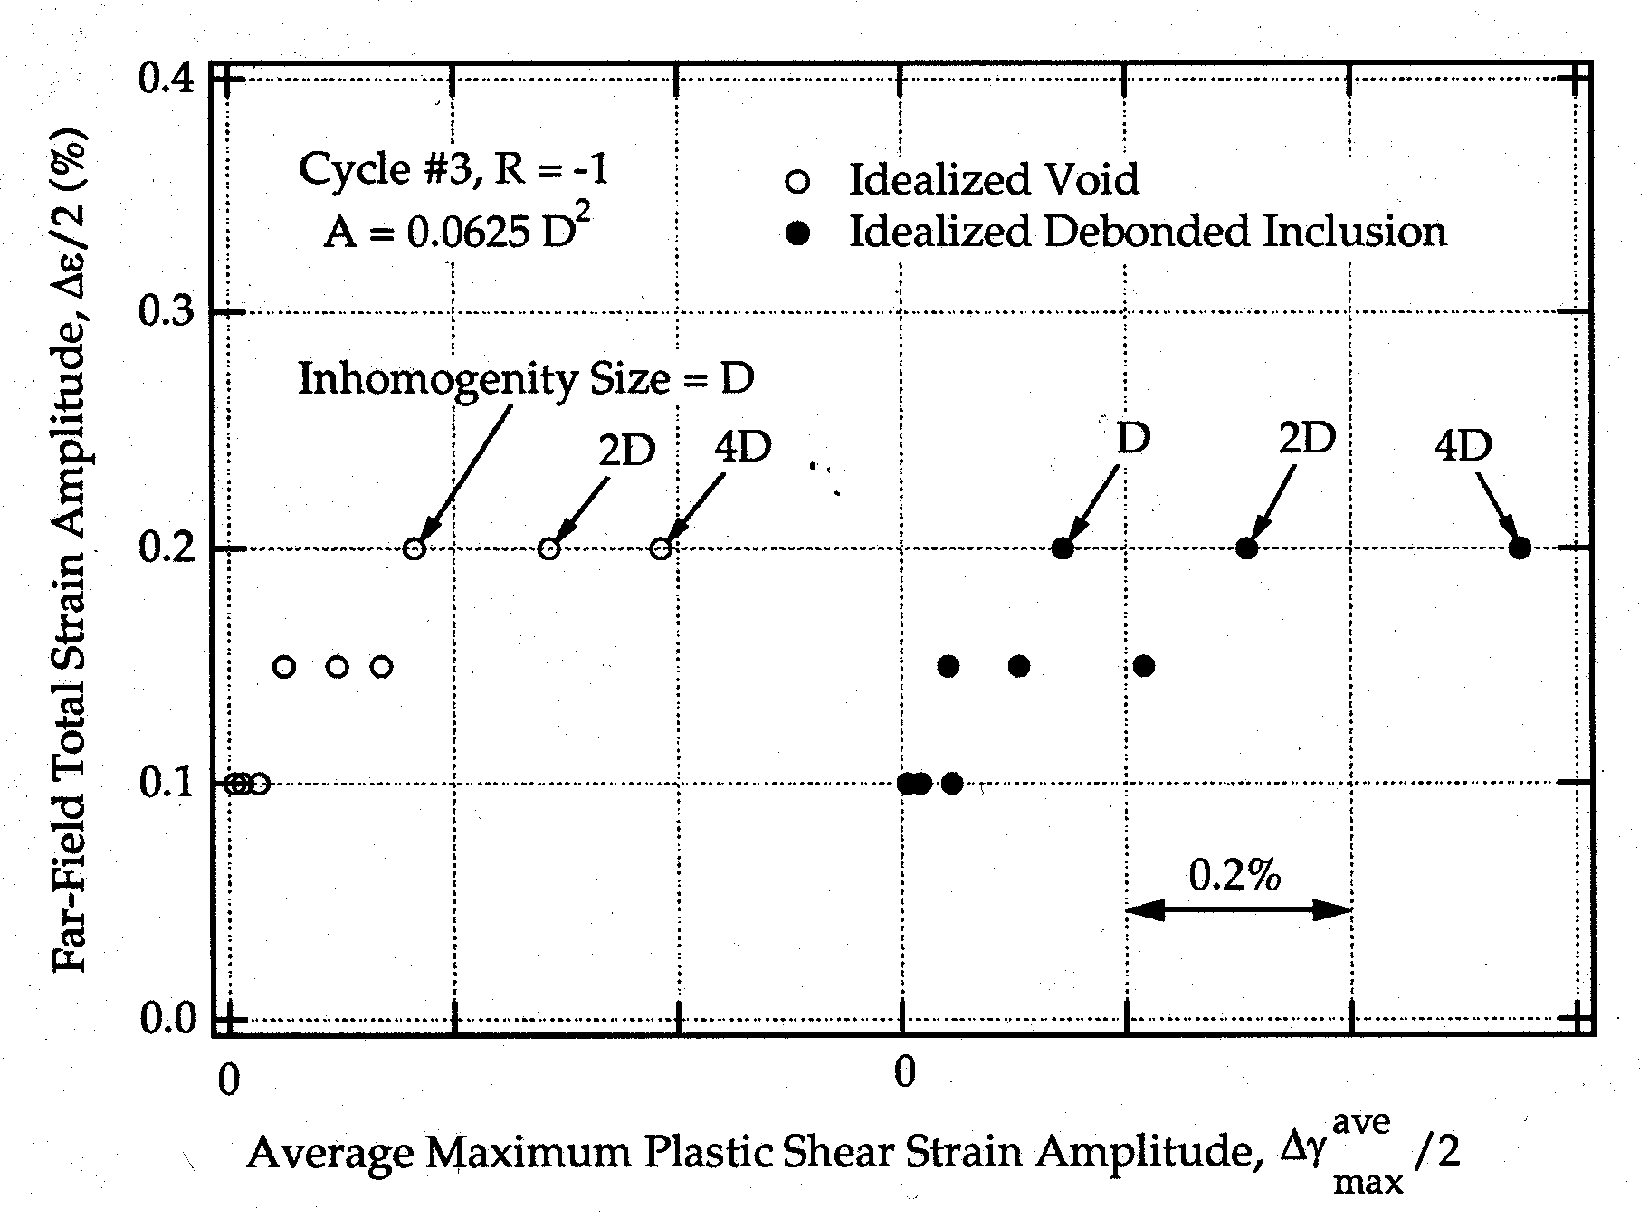
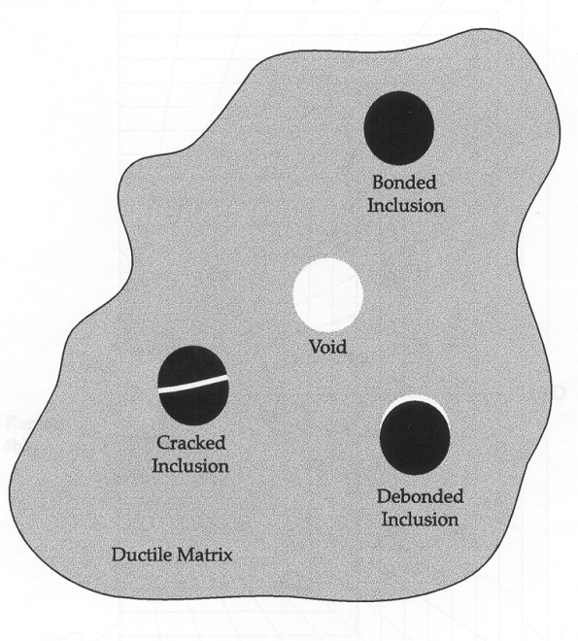
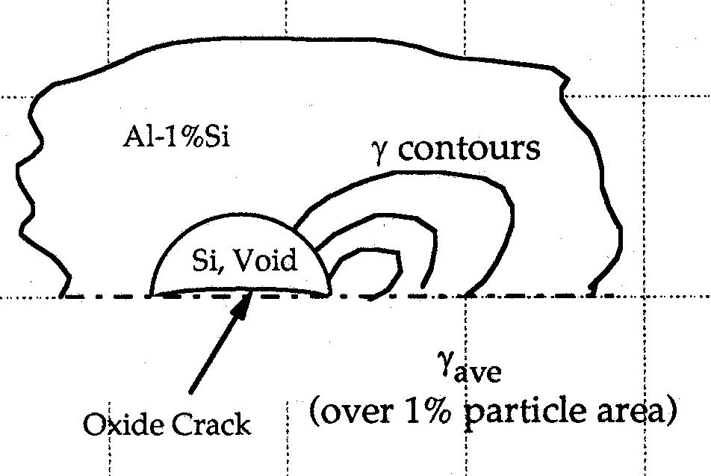

Slide 9
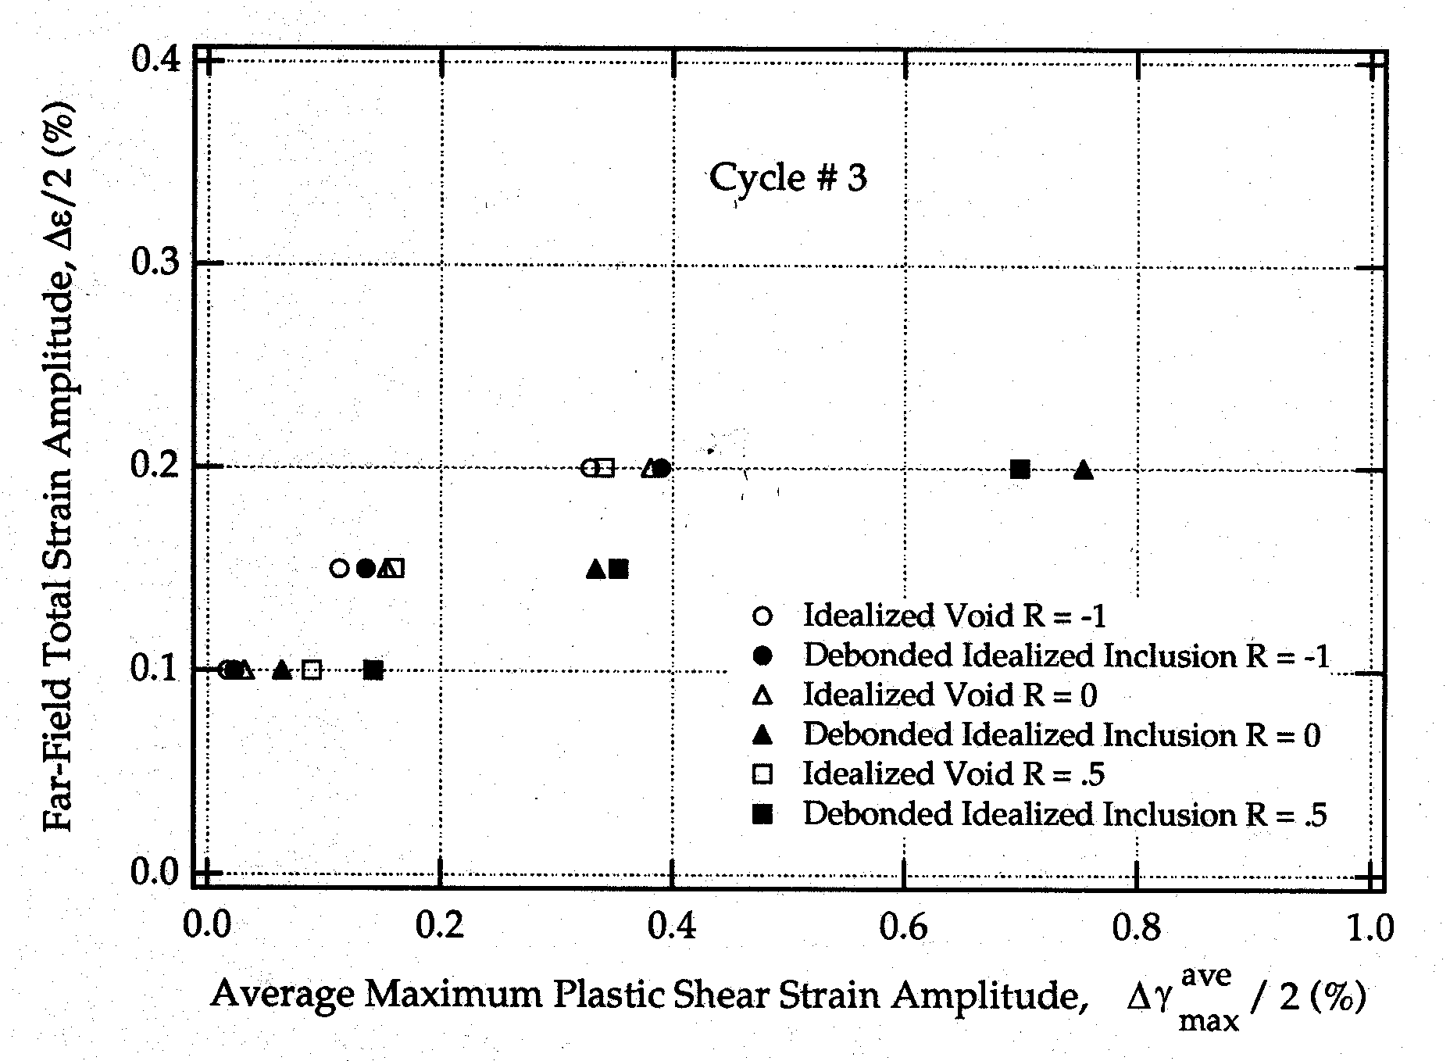

Slide 10
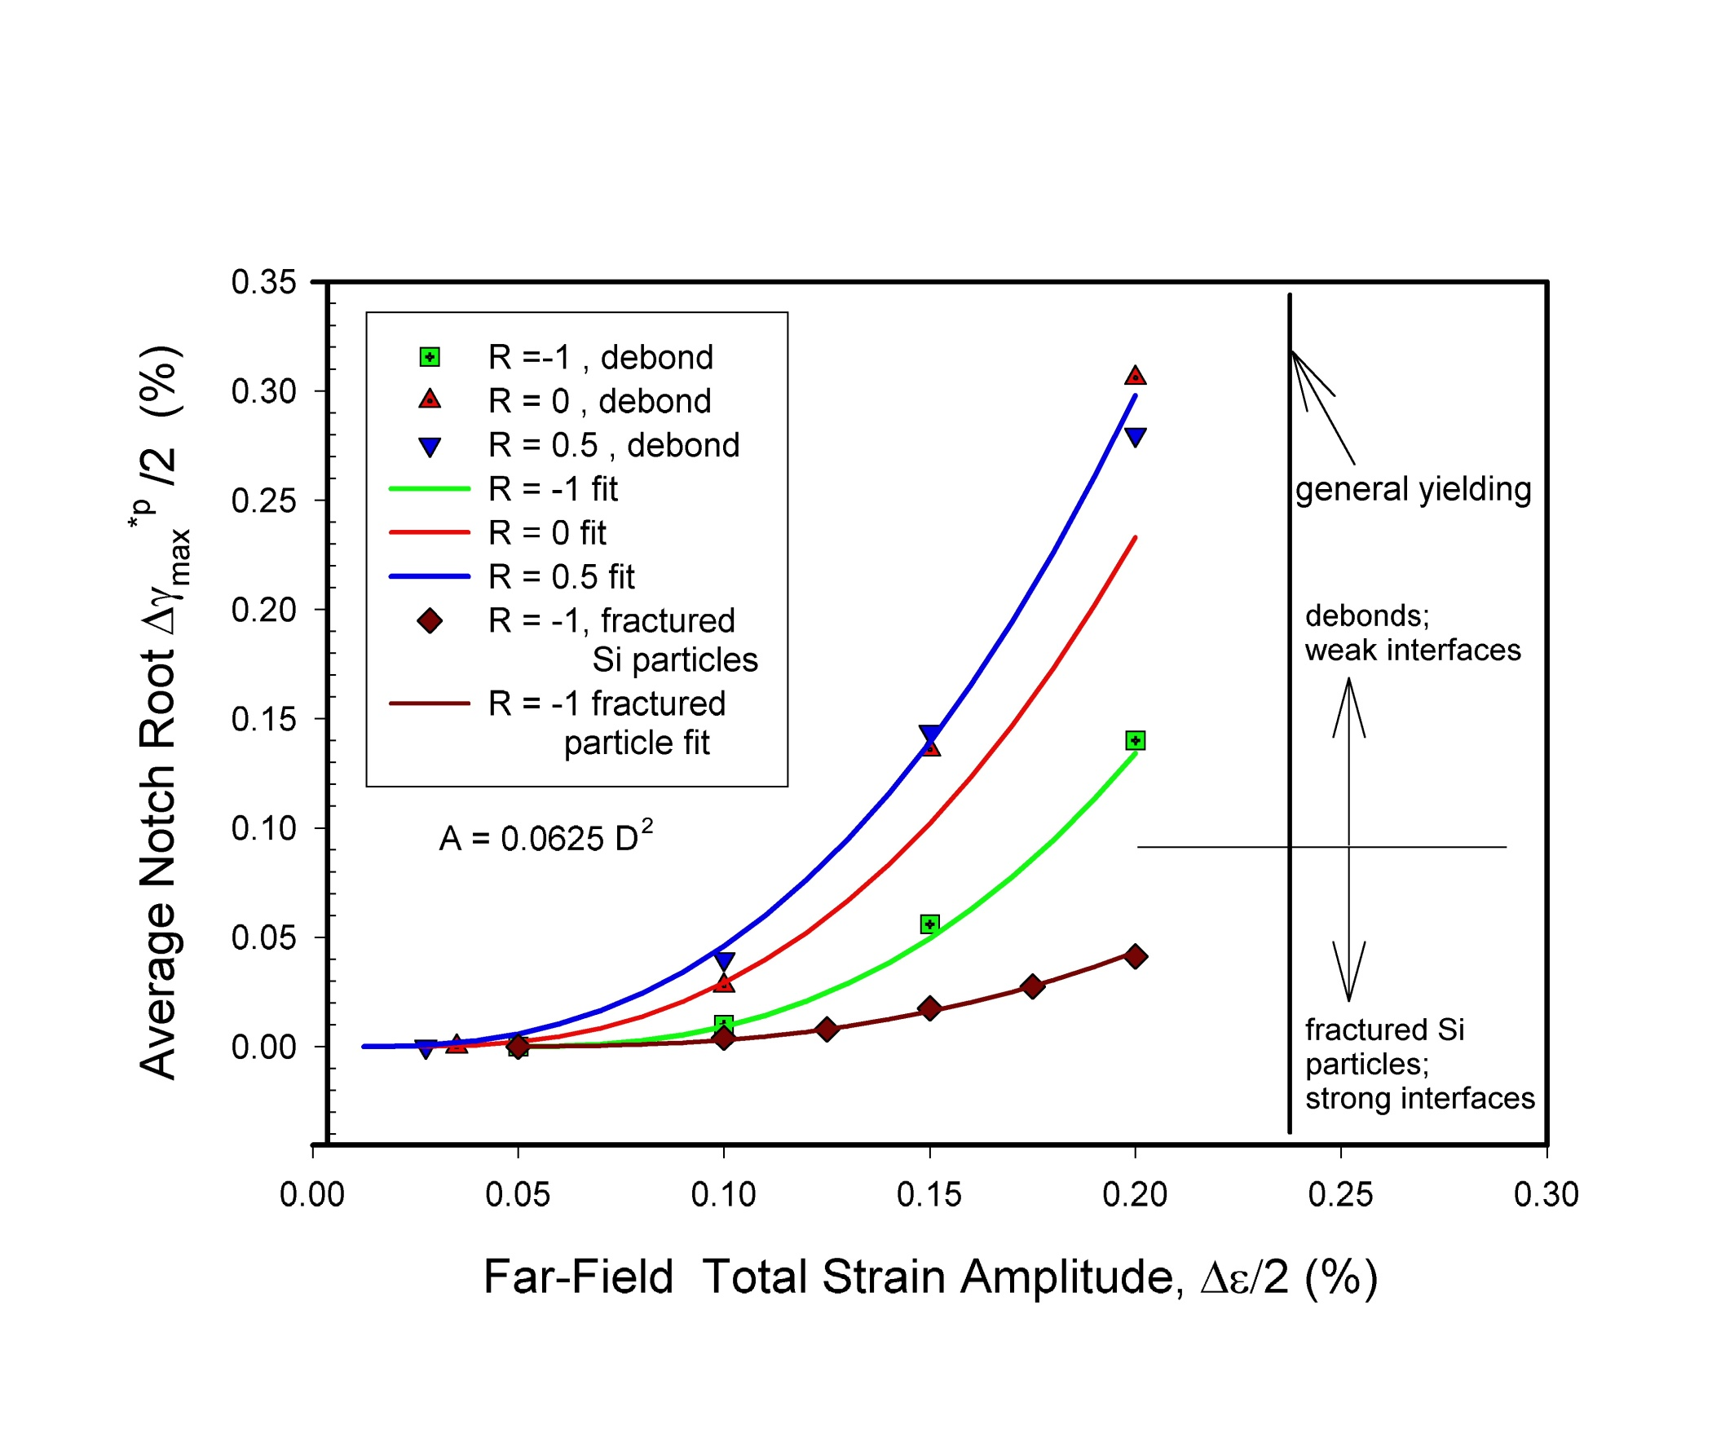

Slide 11
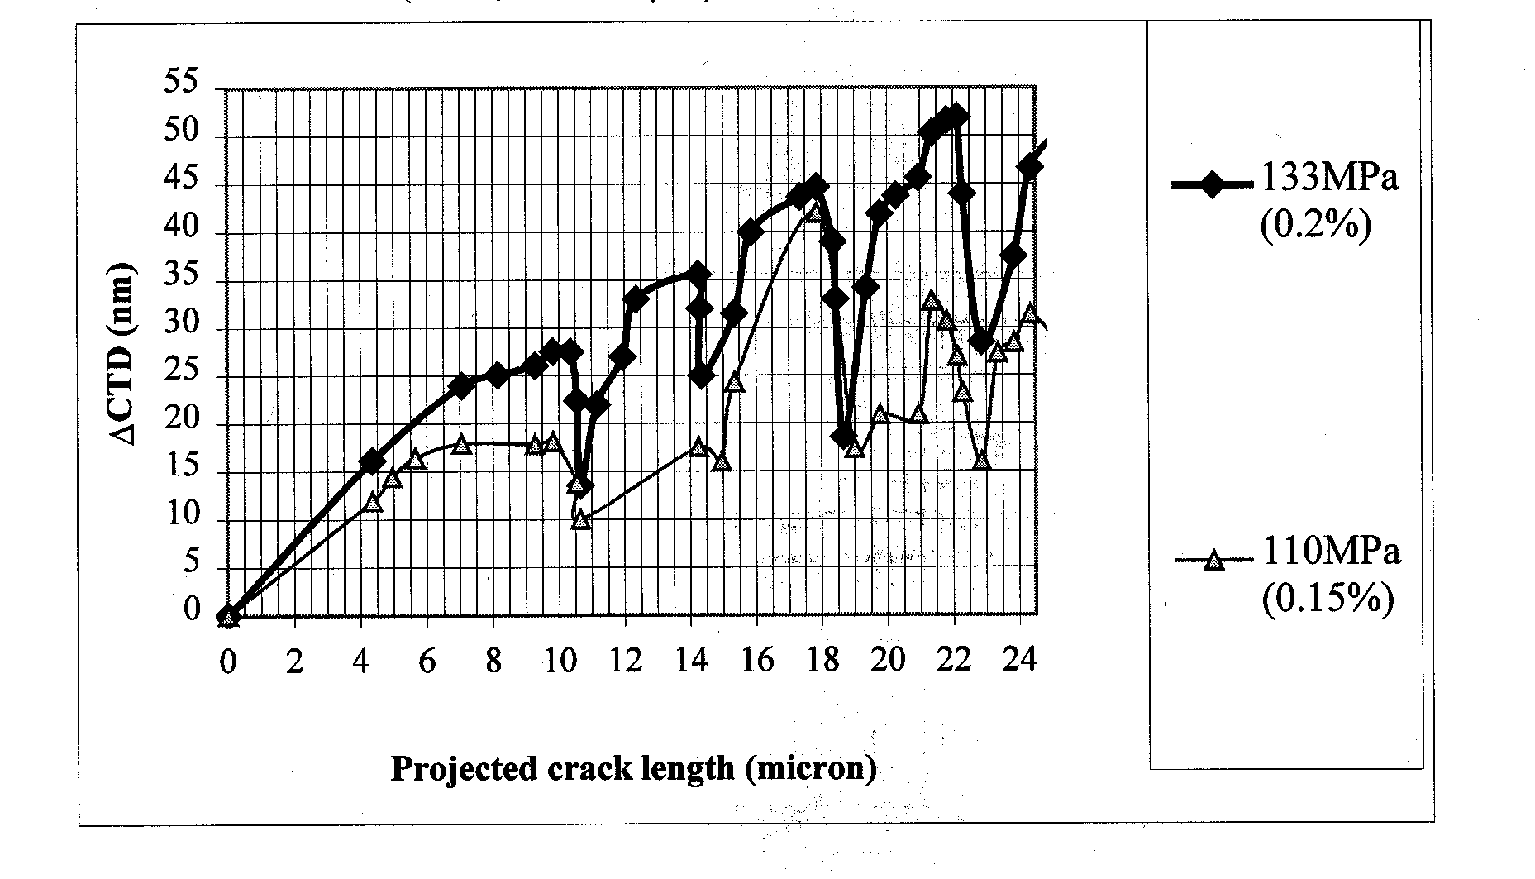

Slide 12
(mm-m)
Bridge 12 = material model
Macroscale MSF Model
Bridge 10 =
MSC growth
(10-100 μm)
Bridge 9=
Crack Incubation
Bridge 7 =
Crack tip
driving force
(μm)
(nm)

Slide 14
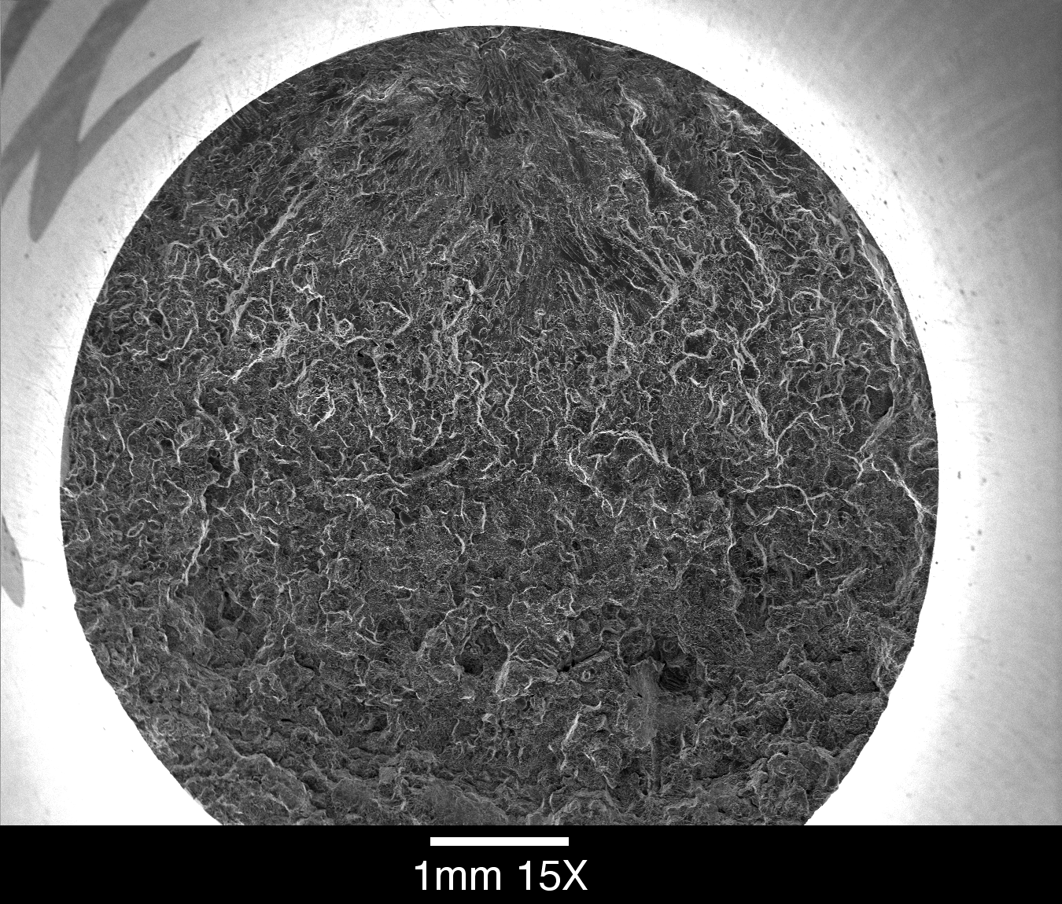
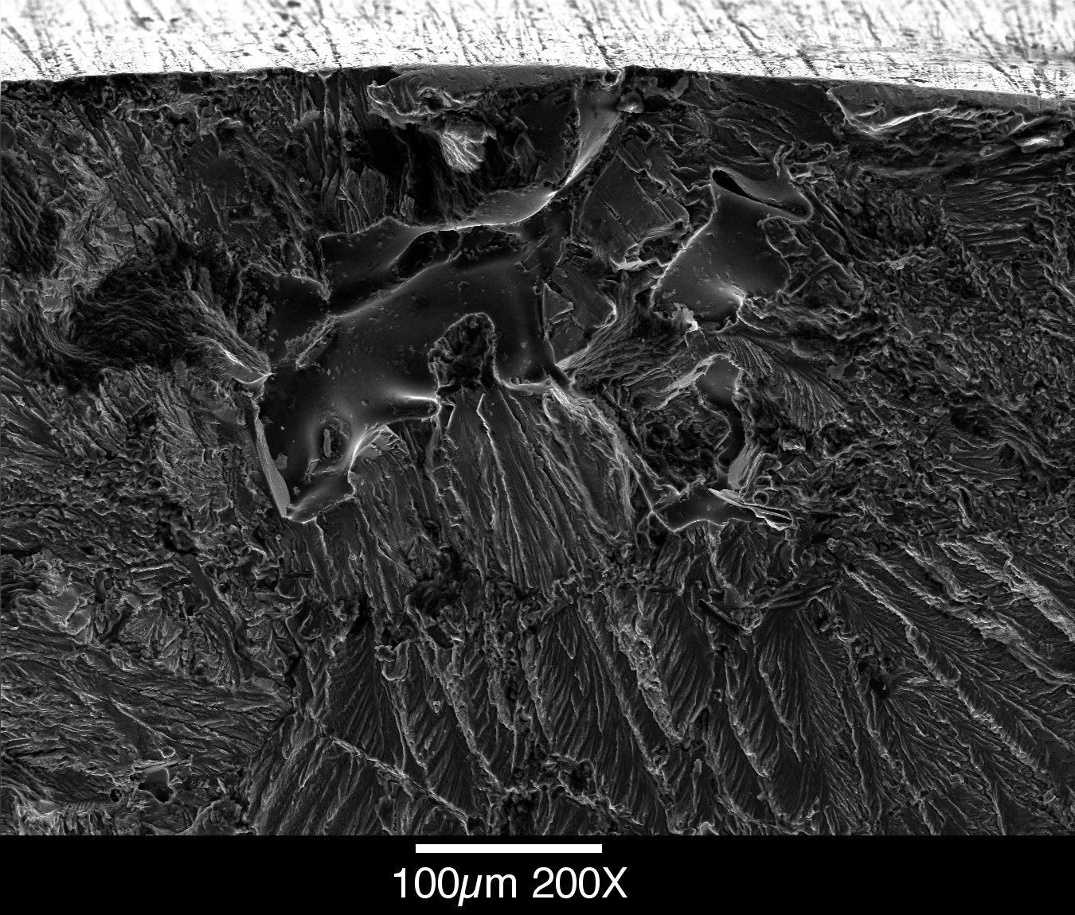
(a)
casting pore
(b)

Slide 15
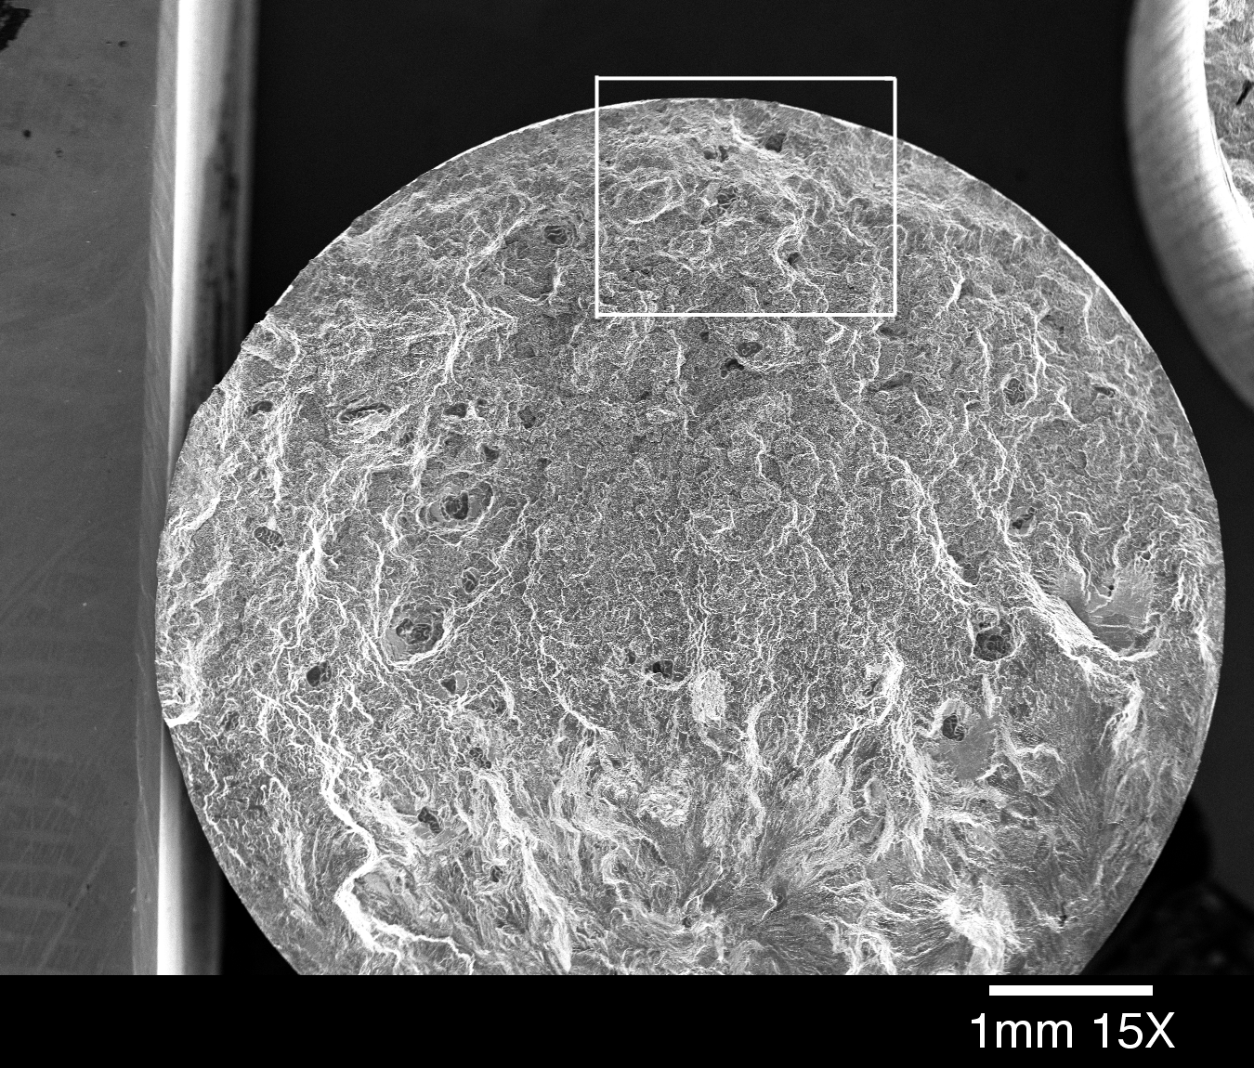
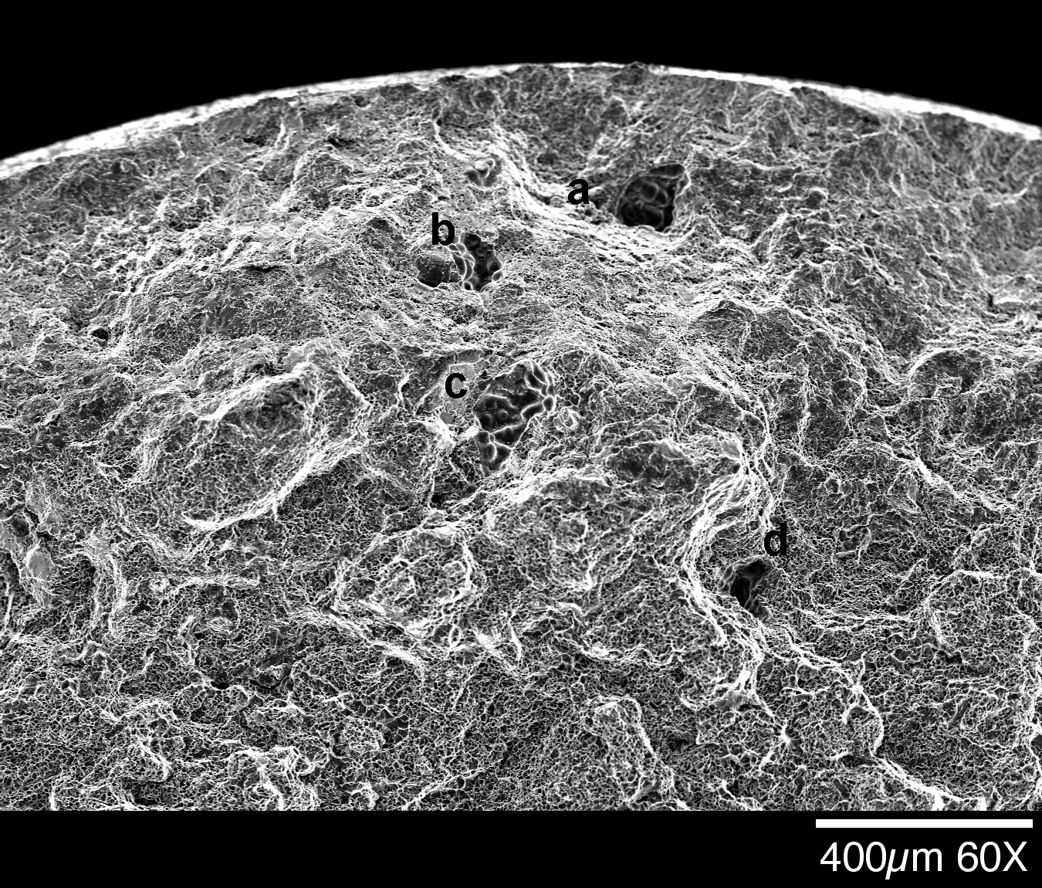
casting pores
(b)
(a)

Slide 16
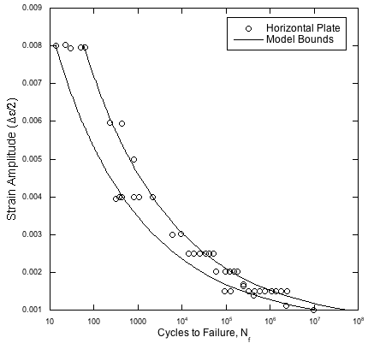

Slide 17
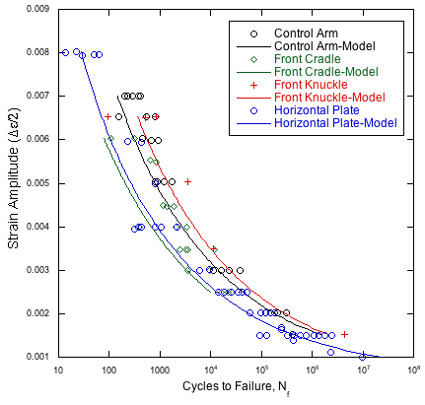

Slide 18
Macroscale MSF Model
Bridge 10 =
MSC Growth
10-100 µm
Mesoscale FEA Simulations

Slide 19
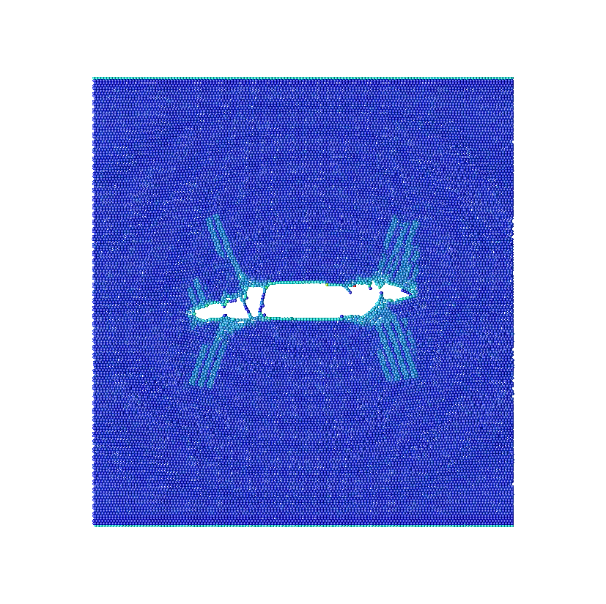

Slide 20
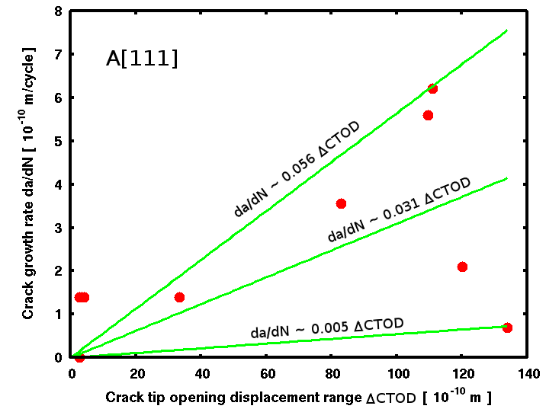
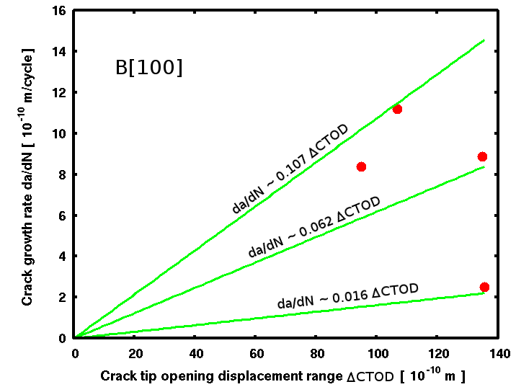
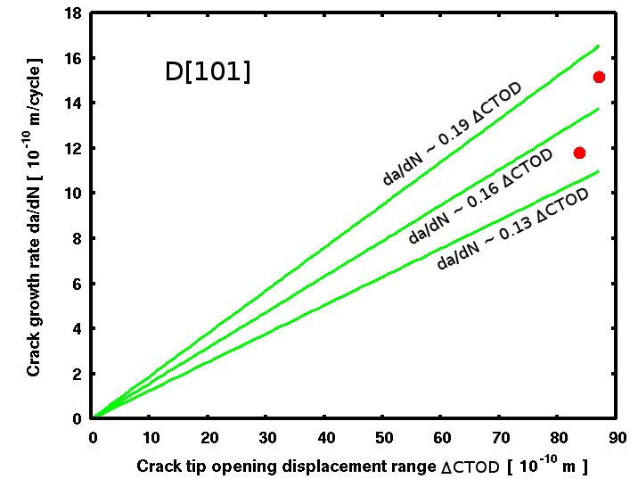

Slide 21
