Slide 1
Quantum Superposition and Optical Transitions
Outline
Generating EM Fields
Time-Varying Wavefunctions
Superposition of Energy States

Slide 2
Maxwell and Schrödinger
Maxwell’s Equations
Quantum Field Theory
… is thought to be the unique and correct outcome of combining the rules of quantum mechanics with the principles of the theory of relativity.
The Schrodinger Equation
The Wave Equation
(free-particle)
Dispersion Relation
Dispersion Relation
Energy-Momentum
Energy-Momentum
(free-particle)

Slide 3
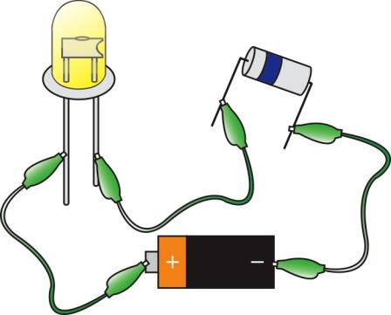
P-N Junctions and LEDs
p-type
n-type
LED
Resistor
Power Source
Resistor
Not
Shown
High energy electrons (n-type) fall into low energy holes (p-type)

Slide 4
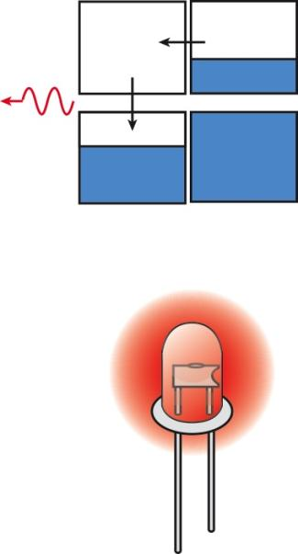
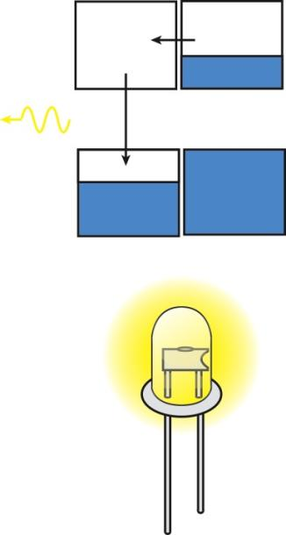
P-N Junctions and LEDs
Red
Light
Emitted
Yellow
Light
Emitted
Small Gap
ENERGY
Large Gap

Slide 5
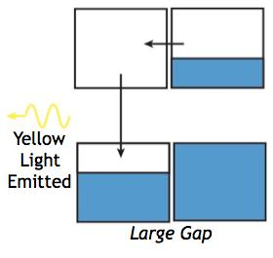
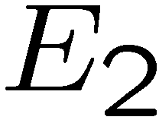

P-N Junctions and LEDs
Uncertain energy during transition from high energy to low energy

Slide 6
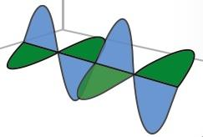
Coupling of Electric and Magnetic Fields
Maxwell’s Equations couple H and E fields..
Oscillating B generates H…
Oscillating E generates H…
How are the oscillating fields generated ?

Slide 7
Time-Dependent Schrodinger Equation
For that matter, how do we get ANYTHING to move ?
states of definite energy
Schrodinger says that definite energy states do not move, they are stationary !

Slide 8
Example: Superposition of Energy States
It is possible that a particle can be in a superposition of “eigenstates” with different energies.
  Such superpositions are also solutions of the time-dependent SEQ!
  What is E of this superposition?
Let’s see how these superpositions evolve with time.
Particle is described by a wavefunction involving a superposition of the two lowest infinite square well states (n=1 and 2)
V=∞
V=∞
0
L
x
Notes:
Look at in terms of phasors (rotating at different frequencies)

Slide 9
Example: Superposition of Energy States
The probability density is given by: |Ψ(x,t)|² :
Because the cos term oscillates between ±1, |Ψ(x,t)|² oscillates between:
Probability
0
L
x
0
L
x
particle localized on left side of well
particle localized on right side of well
The frequency of oscillation between these two extremes is
Notes:
Discuss coupling with oscillating field

Slide 10
Numerical Example
Consider the numerical example:
V=∞
V=∞
An electron in the infinite square well potential is initially (at t=0) confined to the left side of the well, and is described by the following wavefunction:
0
L
x
V=∞
V=∞
If the well width is L = 0.5 nm, determine the time t_{o} it takes for the particle to “move” to the right side of the well.
0
L
x
period T = 1/f = 2t₀ with f = (E₂-E₁)/h

Slide 11
Example: Superposition of Energy States
Consider a particle in an infinite potential well, which at t= 0 is in the state:
with ψ₂(x) and ψ₄(x) both normalized.
0
L
x
If we measure the energy of the particle: What is the measured energy?
(a) E₂ (b) E₄ (c) 0.25 E₂ + 0.75 E₄
(d) It depends on when we measure the energy
2. If we measure the energy of the particle: What is the expected (average) energy?
(a) E₂ (b) E₄ (c) 0.25 E₂ + 0.75 E₄
(d) It depends on when we measure the energy

Slide 12
Normalizing Superposition States
It’s a mathematical fact that any two eigenstates with different eigenvalues (of any measurable, including energy) are ORTHOGONAL
        Meaning:
So when you normalize a superposition of normalized energy eigenstates,
you just have to make the sum of the absolute squares of their coefficients come out 1.
V=∞
V=∞
0
L
x

Slide 13
Energy of Superposition States
The important new result concerning superpositions of energy eigenstates is that these superpositions represent quantum particles that are moving. Consider:
But what happens if we try to measure E on a wavefunction which involves more than one energy?
  We can still only measure one of the allowed energies,
  i.e., one of the eigenstate energies (e.g., only E₁ or E₂ in Ψ(x,t) above)!
If Ψ(x,t) is normalized, |A₁|² and |A₂|² give us the probabilities that
energies E₁ and E₂, respectively, will be measured in an experiment!
When do we not know the energy of an electron ?

Slide 14
Beautiful Consistency
At what frequency does the charge oscillation occur ?
How much energy does the field take away ?
What is the energy of the photon that is released ?
Quantum mechanics gives us the oscillating dipole,
Maxwell gives us the field !

Slide 15

Atomic Transitions
r
2p
1s
photon

Slide 16
Solar Cells and Photodetectors
r
2p
1s
Emission
photon
Classical: Oscillating electric field drives charge oscillation
Quantum: Electric field creates superposition of energy states
– which have an oscillating charge density

Slide 17
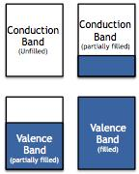
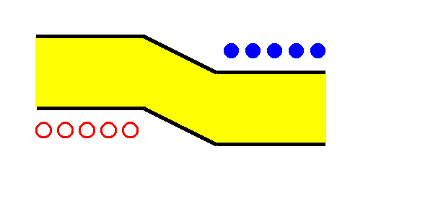
(junction of two differently doped pieces of the same semiconductors)
Semiconductor Homojunction Solar Cell
p-type Silicon
n-type Silicon
IT IS ENERGETICALLY FAVORABLE FOR ELECTRONS TO GO TO THE MATERIAL ON THE RIGHT
electron
CONDUCTION
BAND
METAL
CONTACT
VALENCE
BAND
IT IS ENERGETICALLY FAVORABLE FOR HOLES TO STAY IN THE MATERIAL ON THE LEFT
METAL
CONTACT
hole
Resistor
A
V
Animated
Photogeneration

Slide 18
MIT OpenCourseWare
http://ocw.mit.edu
6.007 Electromagnetic Energy: From Motors to Lasers
Spring 2011
For information about citing these materials or our Terms of Use, visit: http://ocw.mit.edu/terms.

