Slide 1
Light Emitting Diodes
Outline
- Luminescence Spectra of Atoms
- LEDs
. p-n Junction
. Light Outcoupling
- Organic LEDs
- Quantum Dots in LEDs

Slide 2
“Characterization of Organic Illumination Systems”
April 1, 1989, Hamburgen et al.
Dimensions in inches
Subject | Electrode Orientation | Electrode Separation | Electrode #1 Penetration | Electrode #2 Penetration
Bok Choy | parallel | 0.5 | 0.5 | 0.5
Mandarin Orange | parallel | 0.38 | 0.38 | 0.38
Cornichon | axial | 0.5 | 0.5 | 0.5
Kosher Pickle | axial | 2.5 | 1.0 | 1.5
Dill Pickle | axial | 2.5 | 1.0 | 1.5
Electrode Position:
Device Under Test
Thermocouple Probe
Electrode Separation
Electrode #1
Penetration
Electrode #2
Penetration

Slide 3
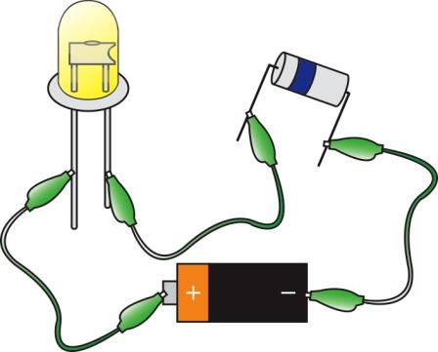
p-n Junctions and LEDs
p-type
n-type
LED
Resistor
Power Source
Resistor
Not
Shown
High energy electrons (n-type) fall into low energy holes (p-type)

Slide 4
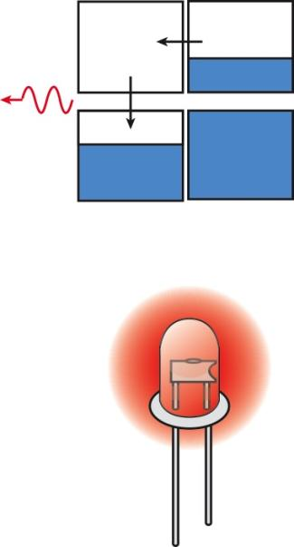
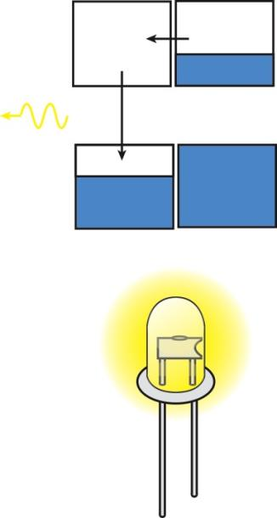
p-n Junctions and LEDs
Red
Light
Emitted
Yellow
Light
Emitted
Small Gap
ENERGY
Large Gap

Slide 5

p-n Diode
Homojunction p-n Light Emitting Diode
n
p
ELECTRICITY IN → LIGHT OUT
Forward Bias condition
ANODE
CATHODE
INJECTED ELECTRONS
CURRENT
p
E_{C}
“+”
E_{g}
Forward
Current
“−”
Breakdown
Voltage
PHOTON EMITTED
n
V_{B}
INJECTED HOLES
Leakage
Current
E_{V}
VOLTAGE
Zero bias condition
Avalanche
Current
NO CHARGE
INJECTED
(NO LIGHT OUT)
p
Reverse
Voltage
Voltage Across Diode
E_{g}
E_{C}
Diode Current
Temperature
n
Saturation
Current in
Reverse Bias
Boltzman
Constant
E_{V}

Slide 6
Extraction Efficiency of Planar LEDs
Escape
Cone
Trapped
light ray
High-index
semiconductor
critical angle of total internal reflection
Problem: Only small fraction of light can escape from semiconductor.
Above equation gives < 10% extraction efficiency for typical III-V.

Slide 7
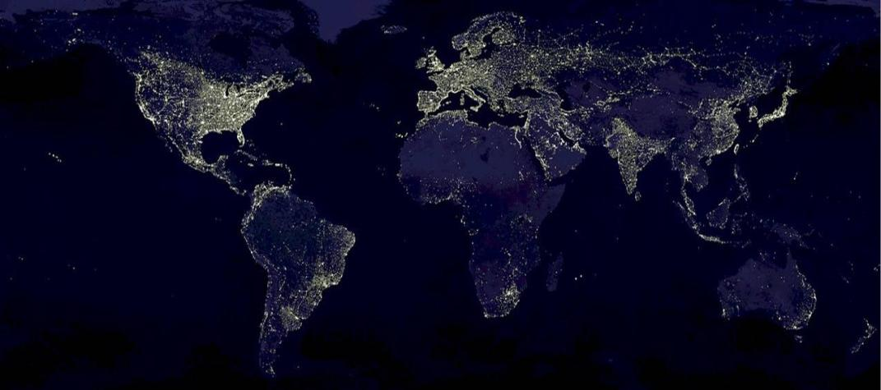
Image in the Public Domain
Artificial Lighting consumes 8% of US energy and 22% of US electricity
The energy cost is estimated at $50B annually or $200 per capita

Slide 8
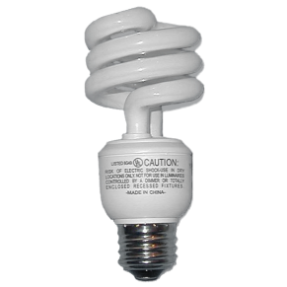
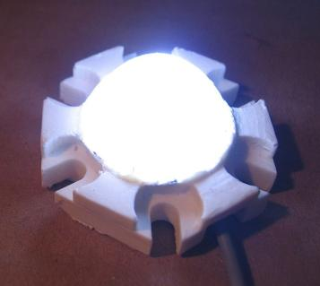

INSTALLED EFFICIENCY FRACTION
Incandescent 5% 12%
Fluorescent 20% 62%
HID lamps 25% 26%
White LEDs 35% ----
All Images are in the Public Domain
Note: Electric Motor Efficiency is 85%~90%

Slide 9
Survey of Lightbulb Technology Performance
(using data from bulbs.com)
QD VISION
NEXXUS 110V LED
COMPACT
FLUORESCENT
CREE
LR6 LED
Luminescence Efficiency [lm/W]
CREE
LRP38 LED
Tradeoff EFFICIENCY for COLOR QUALITY
OTHER LED
TECHNOLOGIES
HALOGEN
INCANDESCENT
Color Rendering Index

Slide 10
OLED: The Green Display
TV and PC Account for 1% each of US Electricity Usage
Power
Usage
[W/in²]
Plasma
0.35
LCD
0.30
RPTV
0.14
OLED
<0.05
Plasma, LCD, RPTV power usage values from 2007 CNet report on commercial TV power consumption. OLED value projected from SID 2007 demo. US household power usage data from 2004 report by the Natural Resources Defense Council.

Slide 11
MIT OpenCourseWare
http://ocw.mit.edu
6.007 Electromagnetic Energy: From Motors to Lasers
Spring 2011
For information about citing these materials or our Terms of Use, visit: http://ocw.mit.edu/terms.

