Slide 1
Examples of Uniform EM Plane Waves
Outline
Reminder of Wave Equation
Reminder of Relation Between E & H
Energy Transported by EM Waves (Poynting Vector)
Examples of Energy Transport by EM Waves

Slide 2




Coupling of Electric and Magnetic Fields
Maxwell’s Equations couple H and E fields…
Source free
The Wave Equation

Slide 3







Magnetic Field in a Uniform Electromagnetic Plane Wave
In free space …
… where

Slide 4



Uniform Electromagnetic Plane Waves In Materials
Inside a material …
… where
is known as the phase velocity

Slide 5
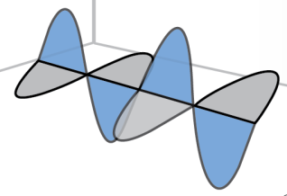


The Characteristic Impedance
η is the intrinsic impedance of the medium given by
Like the propagation velocity, the intrinsic impedance is independent of the source and is determined only by the properties of the medium.

Slide 6



Phasor Notation for Uniform Plane Waves
Imaginary numbers are noted differently in science and engineering disciplines.
While scientists use I, engineers use j. The relation between the two is as follows:
Both scientists and engineers think that their version of the imaginary number is
equal to and independently, over time, they developed equations for identical
physical relations that can now only be reconciled if i is set to be equal to -j

Slide 7



Sinusoidal Uniform Electromagnetic Plane Waves
Define the wave number
so that …

Slide 8


Sinusoidal Uniform Electromagnetic Plane Waves
In free space …

Slide 9



Sinusoidal Uniform Plane Waves
Spatial quantities:
Temporal quantities:

Slide 10




Energy Density of a Uniform Plane Wave
Magnetic
Electric
Using less
cumbersome
notation

Slide 11

Power Flow of a Uniform Plane Wave
Poynting Vector,
named after
John Henry Poynting (1852-1914)

Slide 12
Poynting’s Theorem
Ampere
Faraday
Vector identities
Vector manipulations
Wave transport of energy from V through S
Energy conversion within V
Energy storage within V

Slide 13
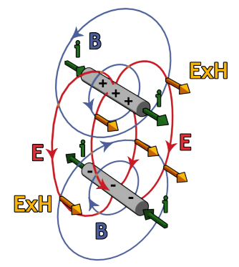
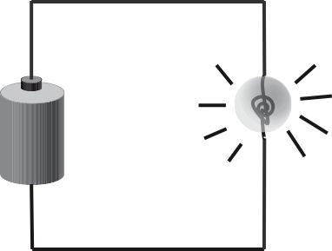
EM Power Flow
Q: How does power flow from the battery to the light bulb?
A: Through the EM fields, which are guided by the wires.
i
+
v
-
i
The wires serve only to guide the fields.

Slide 14
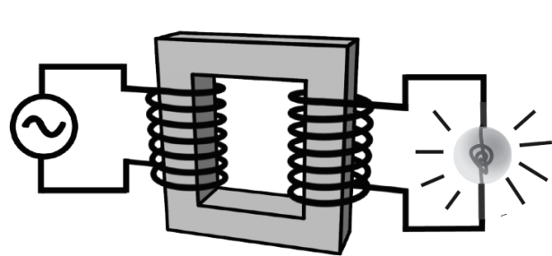

EM Power Flow
Poynting’s Theorem also explains how electrical energy flows from the source through the transformer to the light bulb in the circuit below.

Slide 15

Amplitude & Intensity
How bright is the light?
Amplitude, A Intensity, I
Sound wave:
(loudness)
peak differential pressure p_{o}
power transmitted/area
EM wave:
(brightness)
peak electric field E_{o}
power transmitted/area
Power transmitted is proportional to the square of the amplitude.

Slide 16
Superposition of EM Waves of the Same Polarization
Two –polarized EM waves are incident on the same surface.
EM Wave #2 has four times the peak intensity of EM Wave #1, i.e., .
1. What is the maximum intensity, ?
(a)
(b)
(c)
2. What is the minimum intensity, ?
(a)
(b)
(c)

Slide 17
Pop - Question
If you added the two sinusoidal waves shown in the top plot,
what would the result look like ?
(a)
2
(b)
(c)

Slide 18
Adding Waves with Different Phases
Example: Suppose we have two waves with the same amplitude A₁ and angular frequency ω. Then their wavevectors k are also the same. Suppose that they differ only in phase ф :
and
Spatial dependence of
2 waves at t=0:
Resultant wave:
Trig identity:
Amplitude
Oscillation

Slide 19











The Electromagnetic Spectrum
Wavelength
(m)
10³
10²
10¹
1
10⁻¹
10⁻²
10⁻³
10⁻⁴
10⁻⁵
10⁻⁶
10⁻⁷
10⁻⁸
10⁻⁹
10⁻¹⁰
10⁻¹¹
10⁻¹²
.
Size of a
wavelength
Common
names
Radio waves
Infrared
Ultraviolet
“Hard” X-rays
Visible
Microwaves
“Soft” X-rays
Gamma rays
Sources
AM radio
Microwave
oven
Light
bulb
Radioactive
elements
People
Photon energy
(eV)
10⁻⁹
10⁻⁸
10⁻⁷
10⁻⁶
10⁻⁵
10⁻⁴
10⁻³
10⁻²
10⁻¹
1
10¹
10²
10³
10⁴
10⁵
10⁶
Infrared
Light
ultraviolet
light
|
|
|
|
700 nm
600 nm
500 nm
400 nm

Slide 20
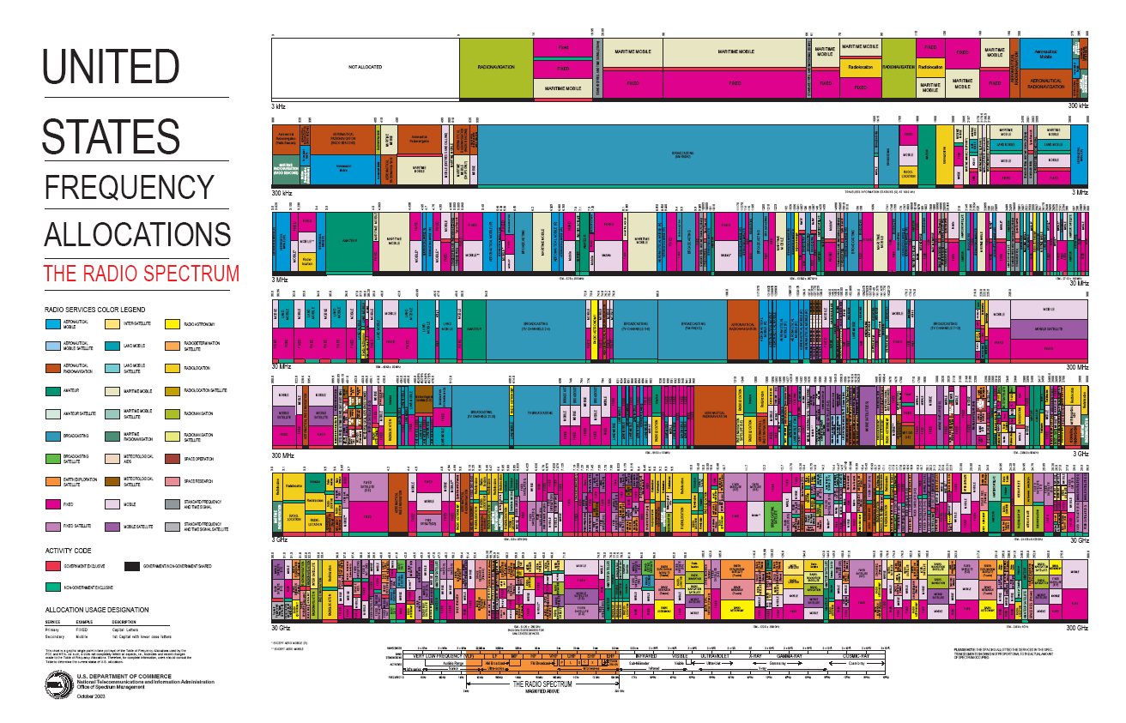
Image from http://www.ntia.doc.gov/osmhome/allochrt.pdf, in public domain

Slide 21

Electromagnetic Fields in Laser Drilling
What are intensity , , , for a 1000-J laser emitting a 1 nsec pulse
at = 1 μm when focused on a 1 mm² spot?
How many cycles in the pulse?
What is approximate E required to spontaneously ionize an atom within one cycle?
{we want energy transferred to roughly exceed electron binding energy within nominal orbital diameter }
Image by Jasper84 (Metaveld BV) <http://commons.wikimedia.org/wiki/File:Lasersnijden_laserkop.jpg>
on Wikimedia, also used for <http://www.metaveld.com>

Slide 22

Electromagnetic Fields from a Cell Phone and the Sun
What are , , , for a cell phone radiating 1-watt of power over 1 m² of Uniform Plane Waves at 1 GHz?
The energy intensity of sunlight shining on Earth is on the order of
~1000 W/m². What is the amplitude corresponding E field ?

Slide 23
If we are going to power the World with solar-generated energy, how much land area has to be covered with Solar Cells?
sun
satellite
World Land Area =149 million km²
World Land/Water Area =510 million km²
US Land Area (48 states) 7.5 million km²
World Consumed Energy
at the rate of 15.8 TW in 2006
US consumed Energy
at the rate of 3TW
atmosphere
Earth
sun at ~37º: air mass 1.5 (AM1.5) 844 W/m²
Terrestrial
Solar cell standard
Solar spectrum outside atmosphere:
air mass 0 (AM0) 1353 W/m²

Slide 24

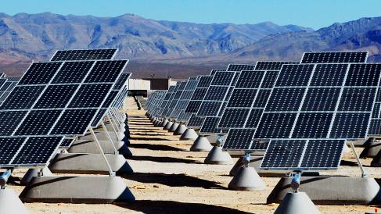
Photovoltaics
-The average power incident upon the surface of the Earth from sunlight is ~10,000 times the average global power consumption.
- The average power incident upon the continental United States is ~500 times our national consumption
(total energy consumption, not just electricity).
If ~2% of the continental United States is covered with PV systems with a net efficiency of 10% we would be able to supply all the US energy needs
(Note: This is an overestimate. We need only 0.35% of US land for PV electricity generation) (Note: 40% of our land is allocated to producing food)
60,000+ farms, 90,000+ farms
Earth and solar panel images are in the public domain

Slide 25
Summary of Properties of a Uniform Plane Waves
1. Propagation velocity with
2. No Electric of Magnetic field in direction of propagation
3. Electric field normal to magnetic field
4. Value of electric field is η times that of magnetic field at each instant
5. Direction of propagation given by
6. Energy stored in electric field per unit volume at any instant at any point is equal to energy stored in magnetic field
7. Instantaneous value of the Pointing vector given by
8. Superposition of EM Plane waves of same frequency and phase adds their electric fields.

Slide 26
MIT OpenCourseWare
http://ocw.mit.edu
6.007 Electromagnetic Energy: From Motors to Lasers
Spring 2011
For information about citing these materials or our Terms of Use, visit: http://ocw.mit.edu/terms.

